Slide 1
Introduction to Google Cloud Platform
By Altotech

Slide 2
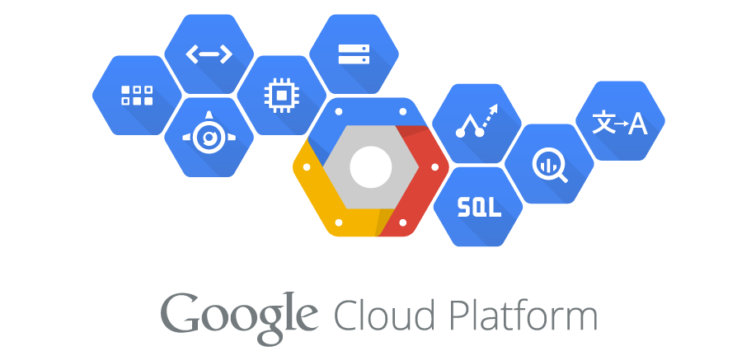

Slide 3
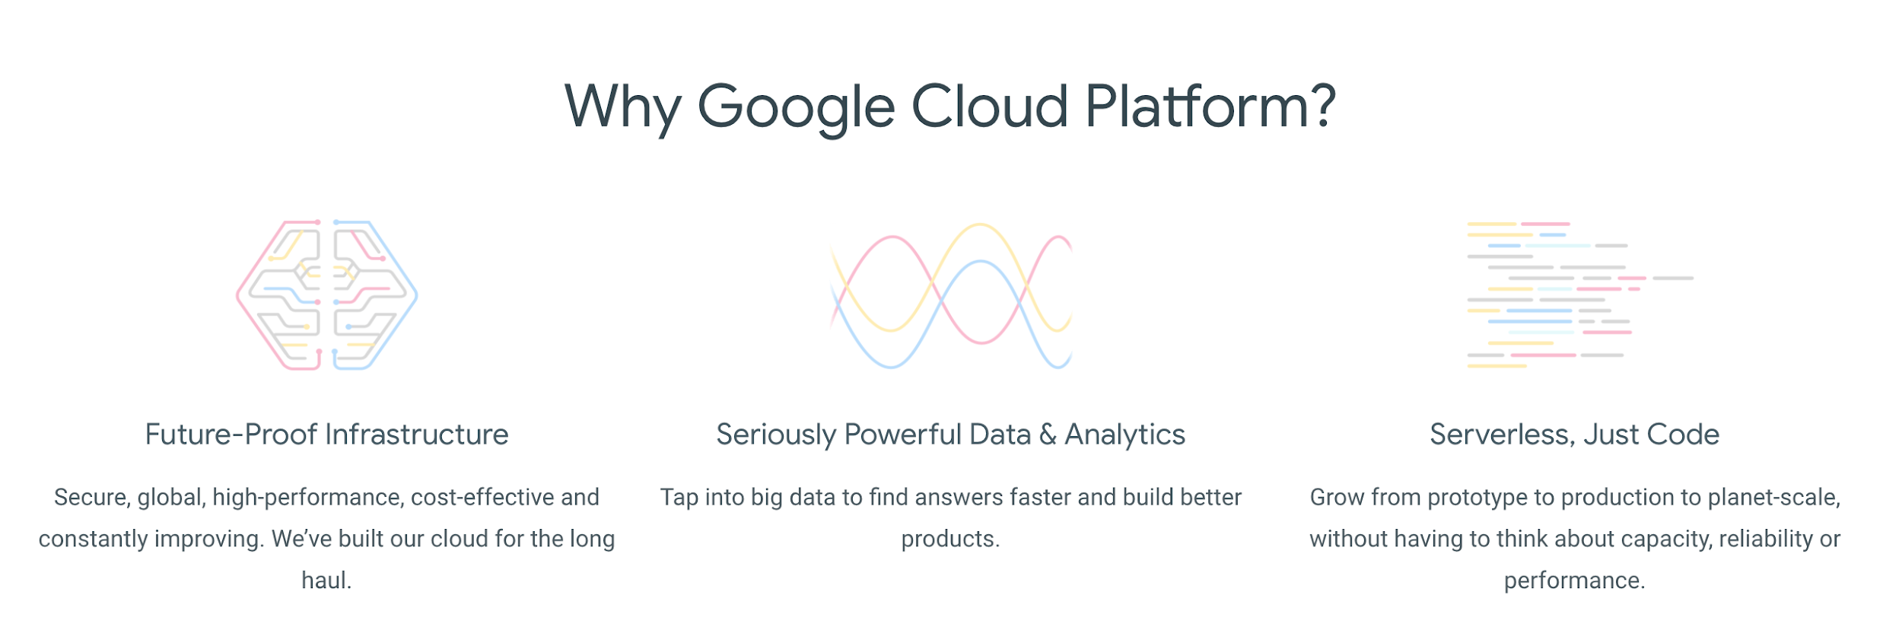

Slide 4
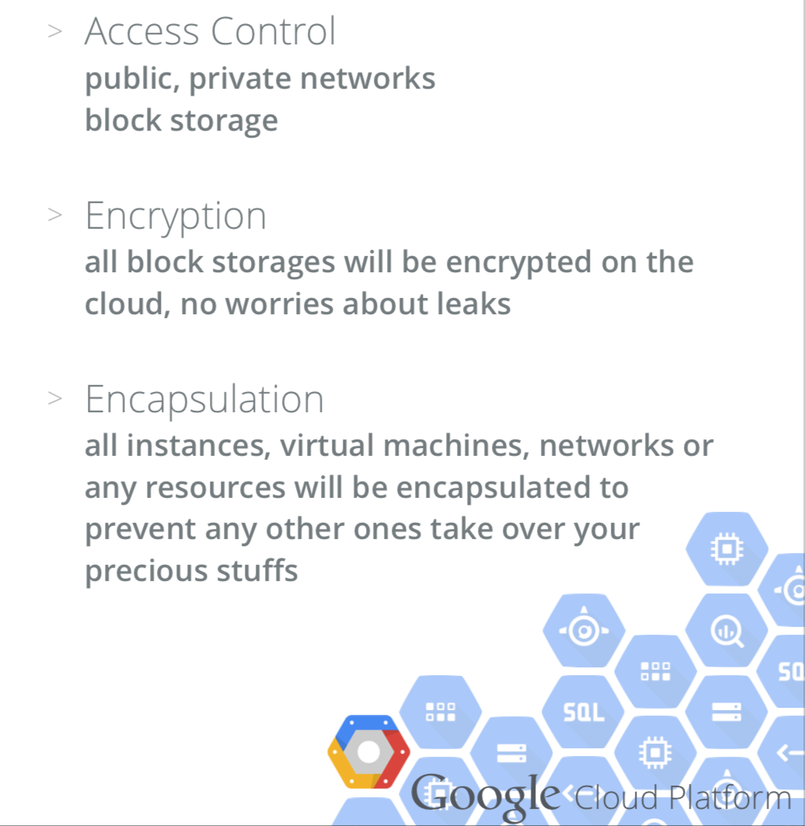

Slide 5
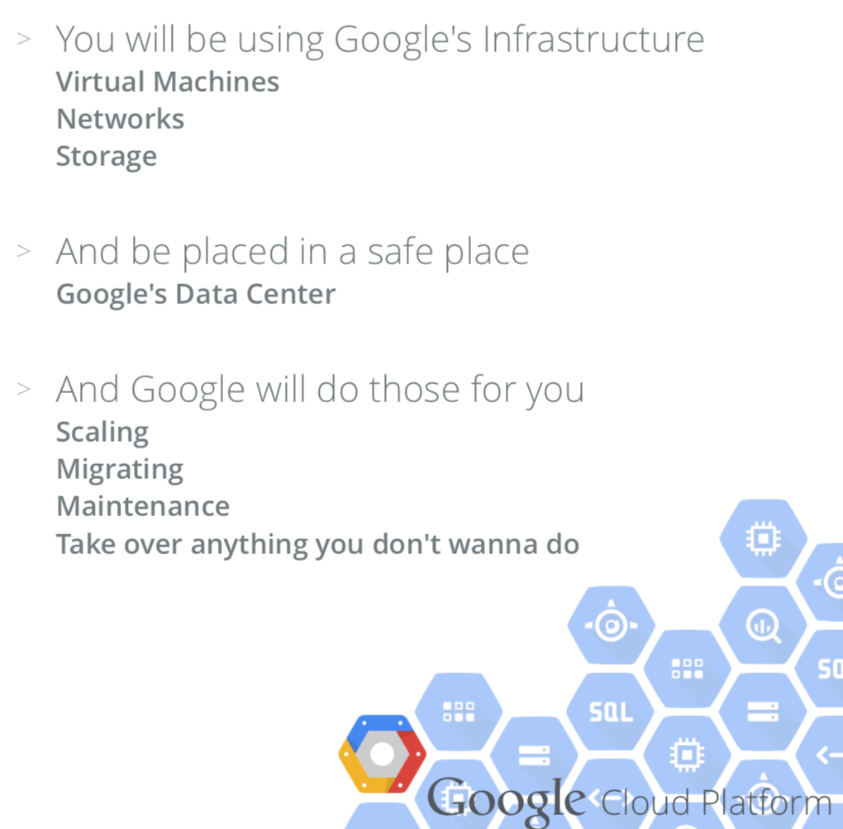

Slide 6
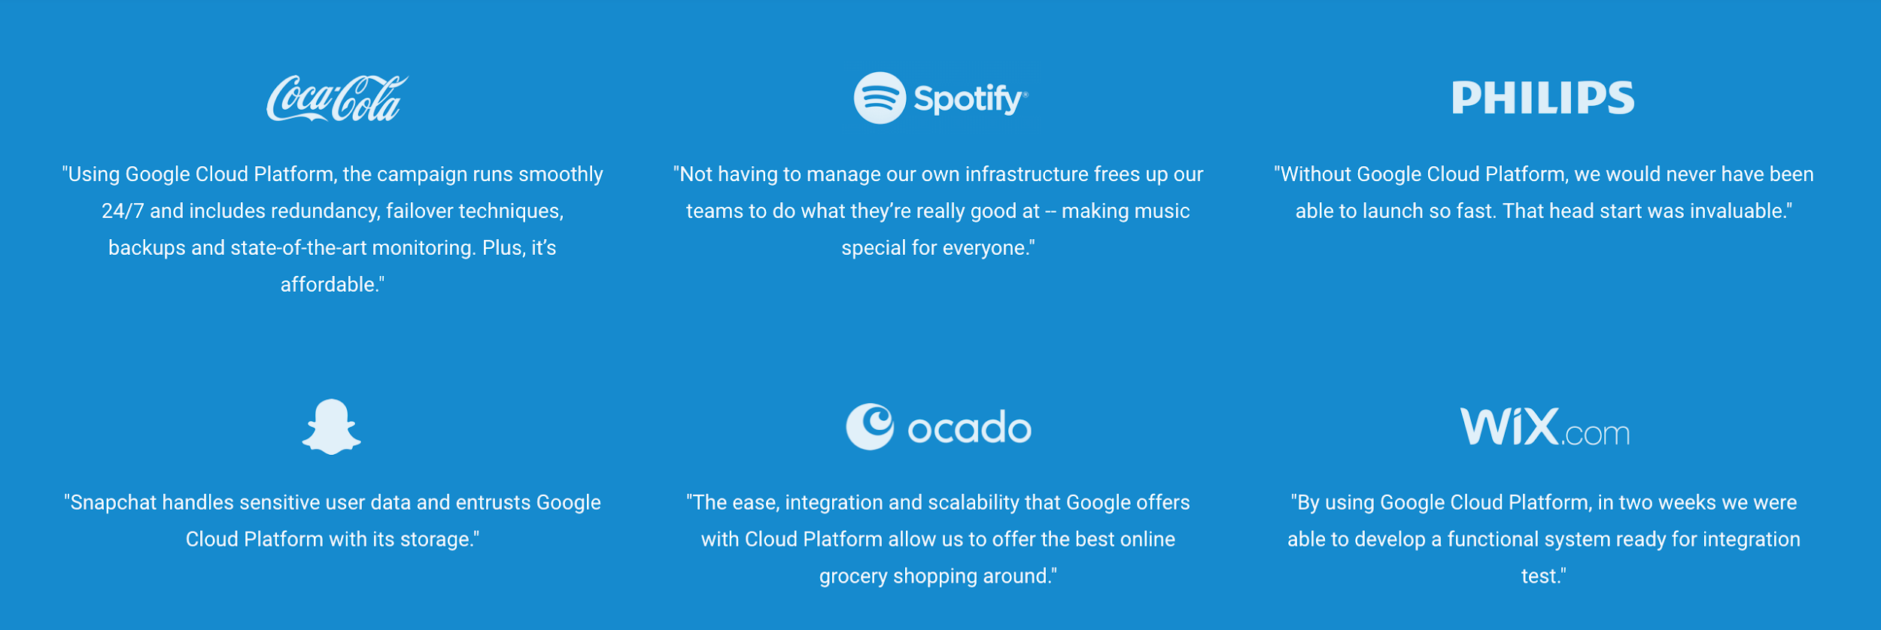

Slide 7
A Closer Look At Google Cloud

Slide 8
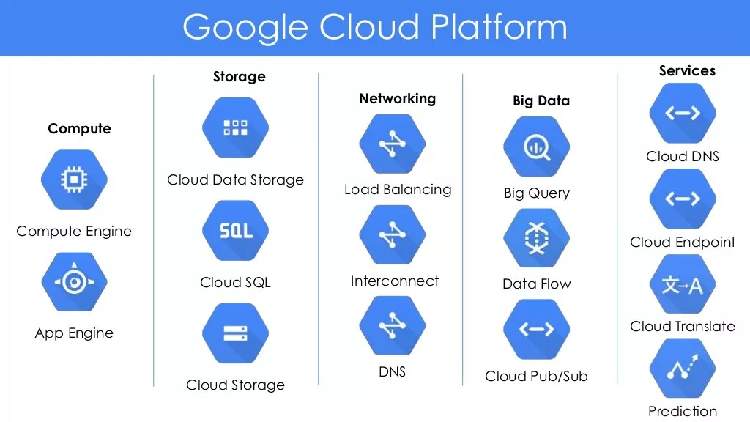

Slide 9
MORE CLOSER!!!

Slide 10
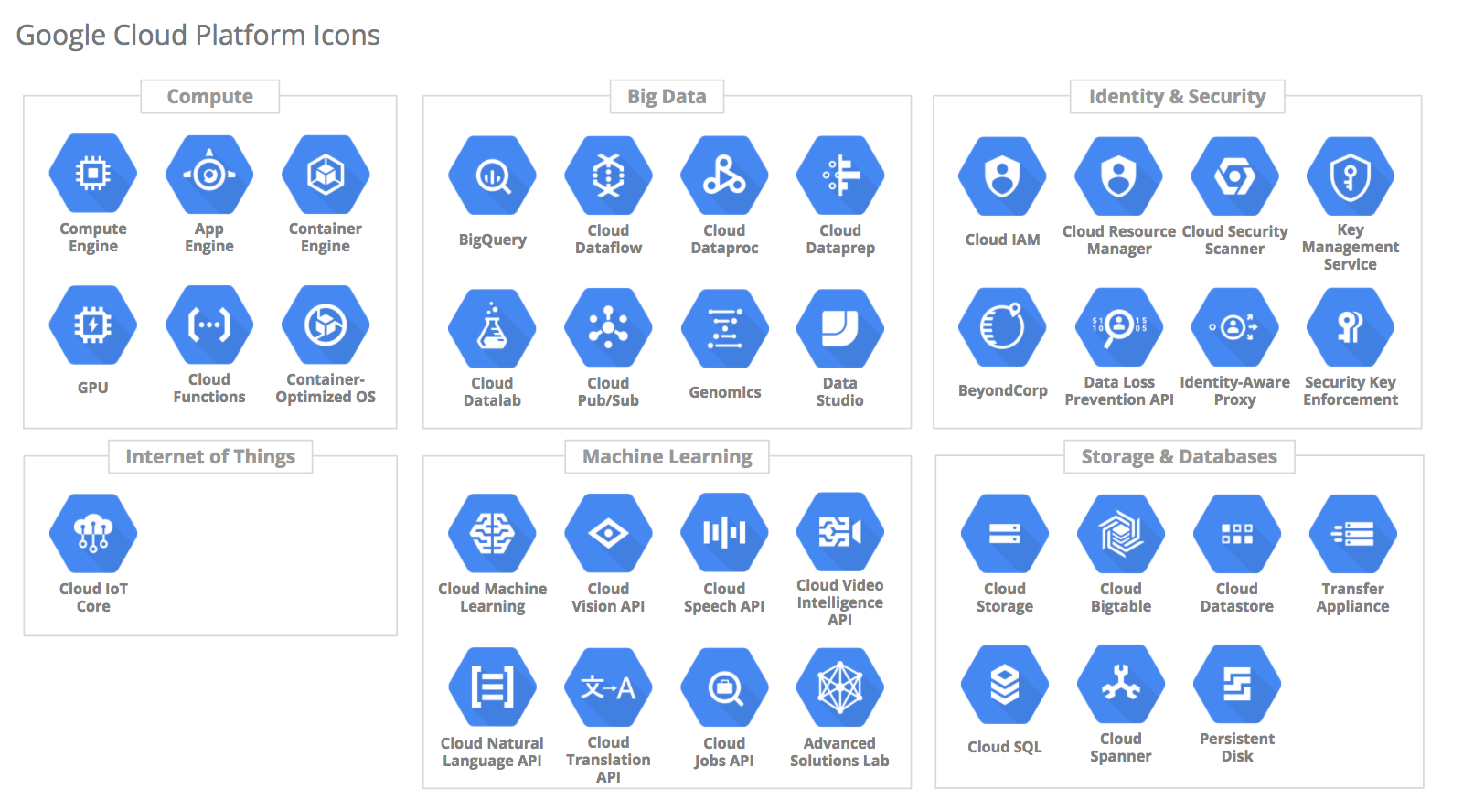

Slide 11
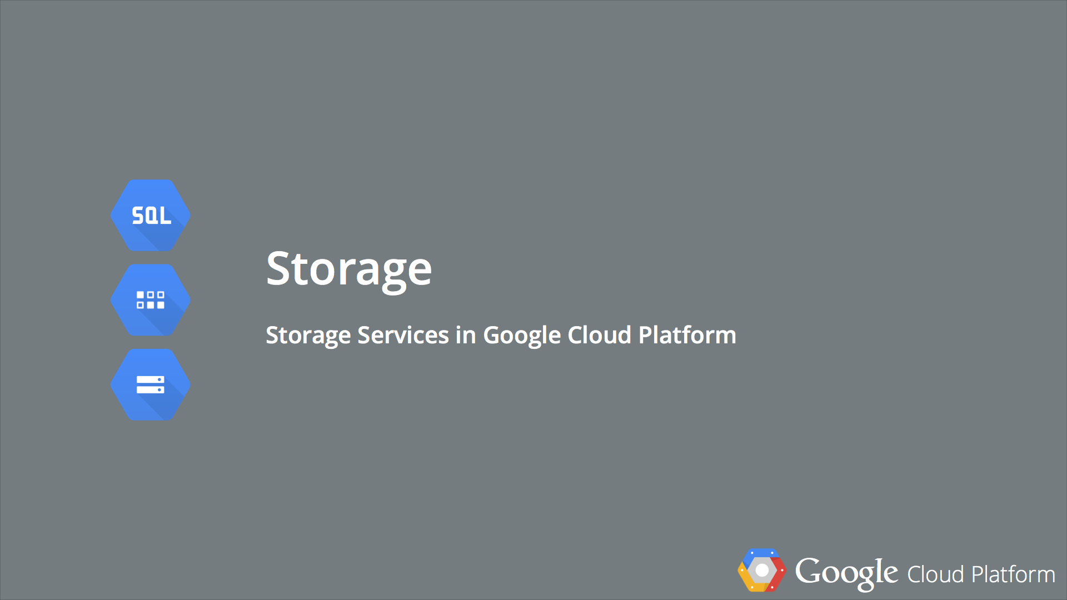

Slide 12
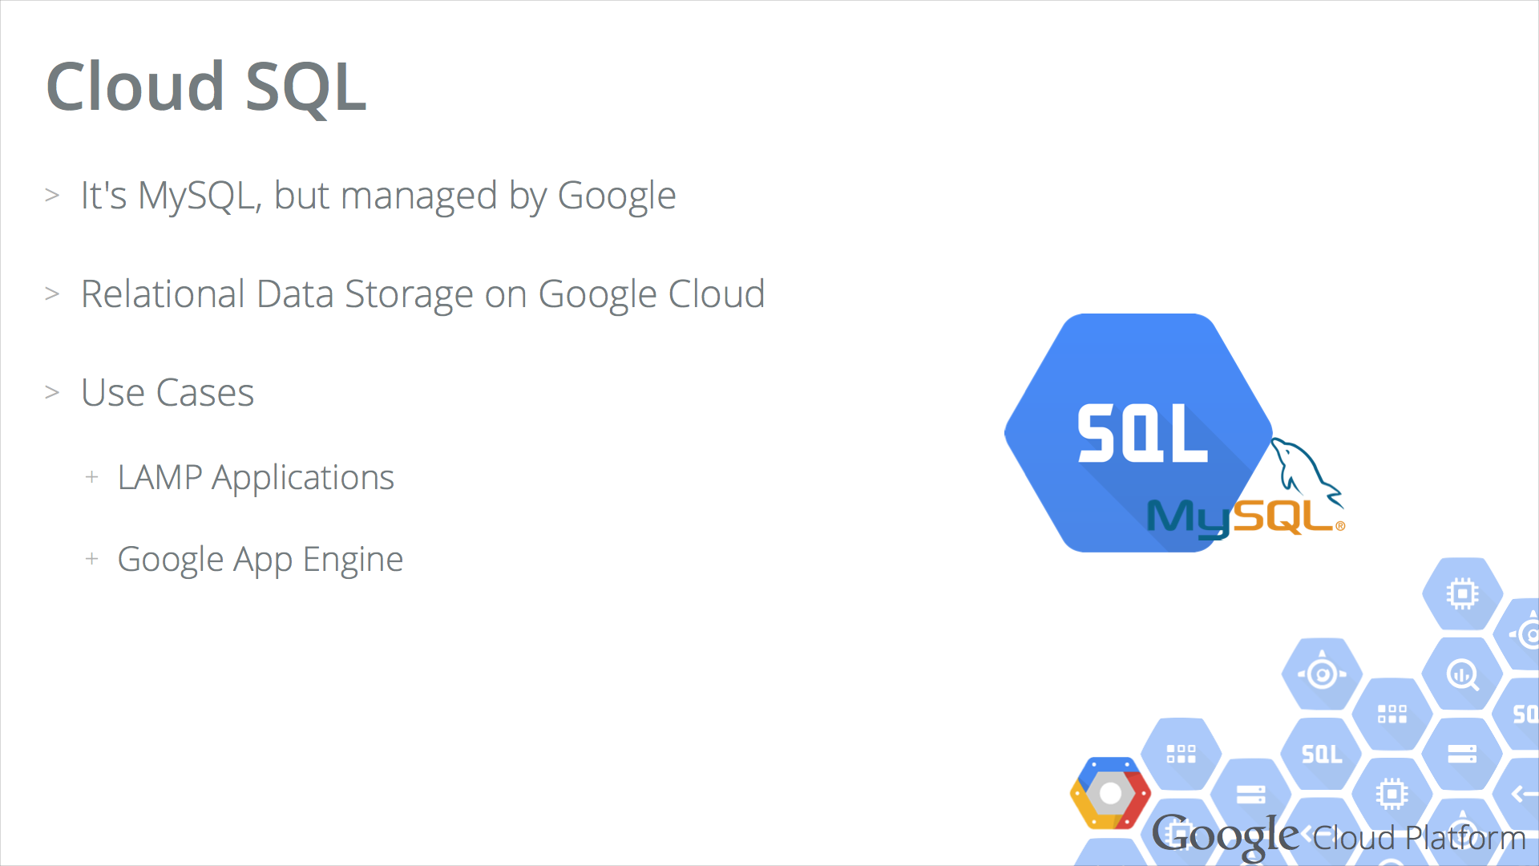

Slide 13
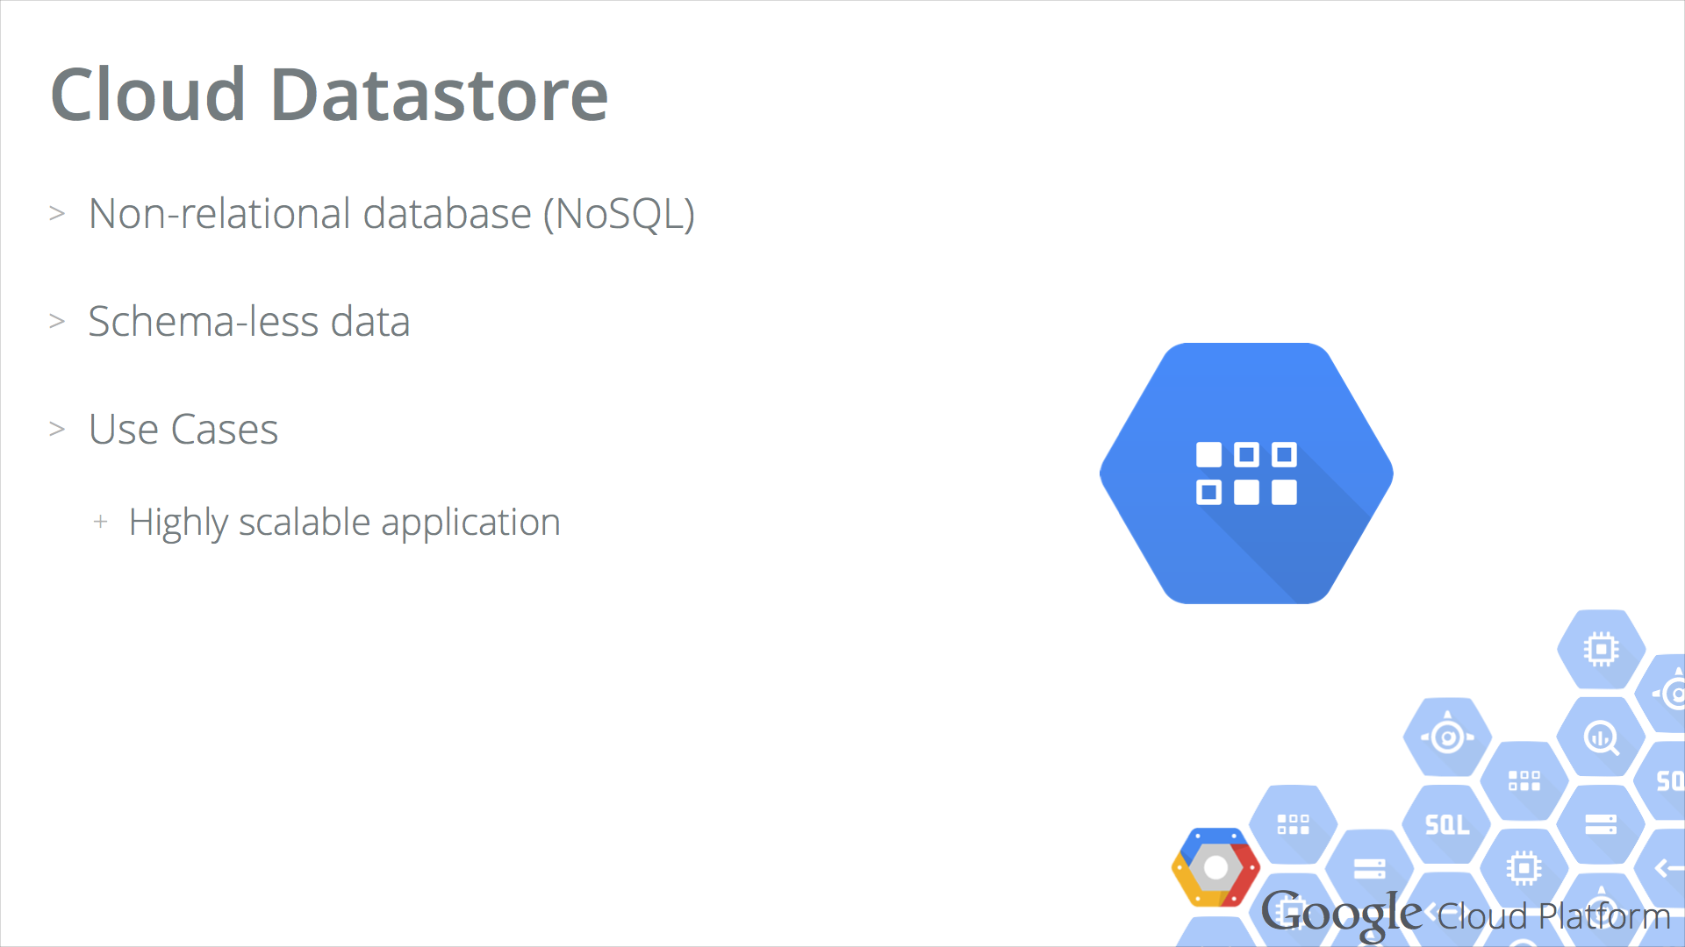

Slide 14
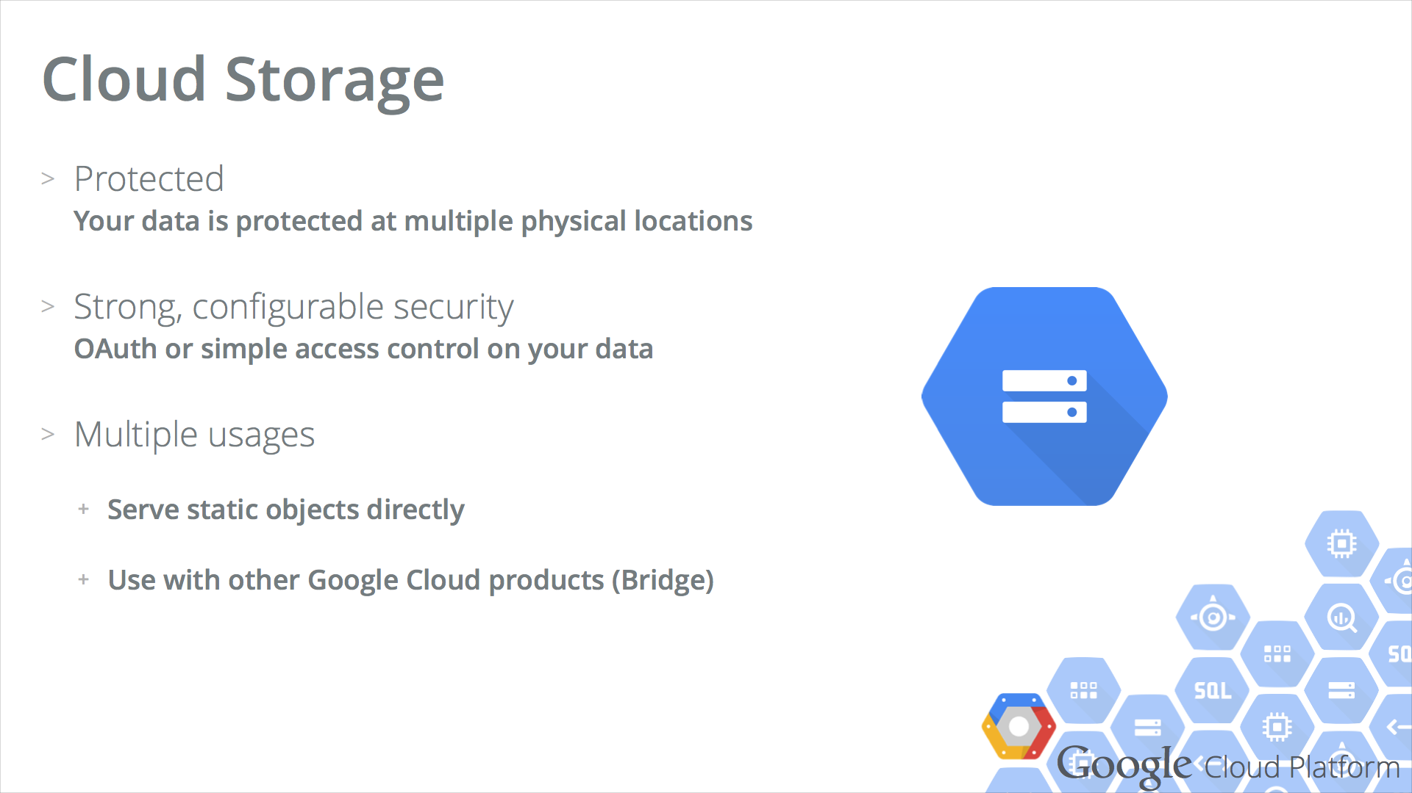

Slide 15
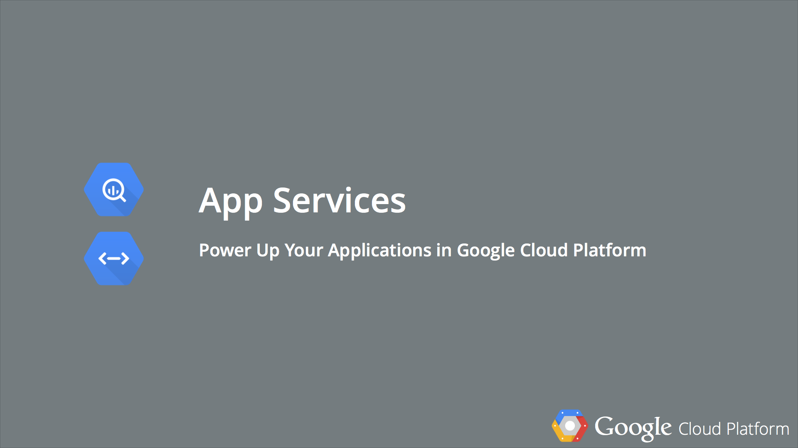

Slide 16
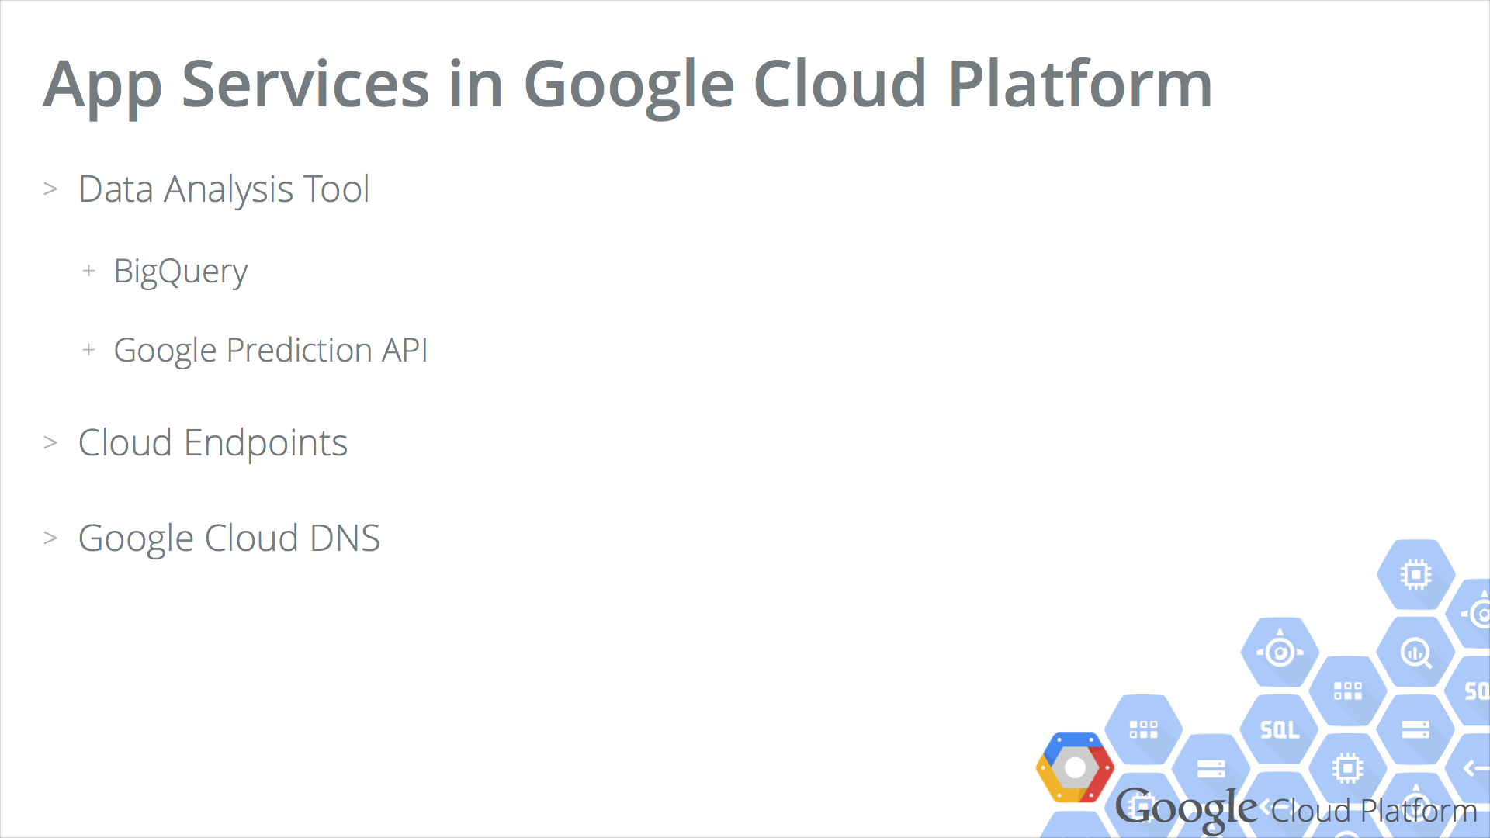

Slide 17
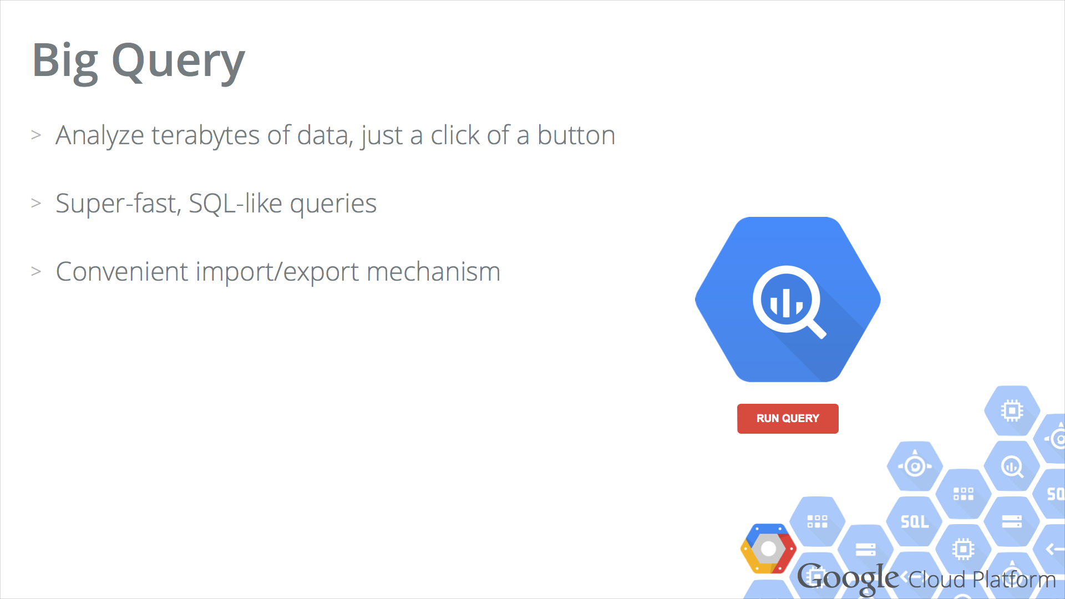

Slide 18
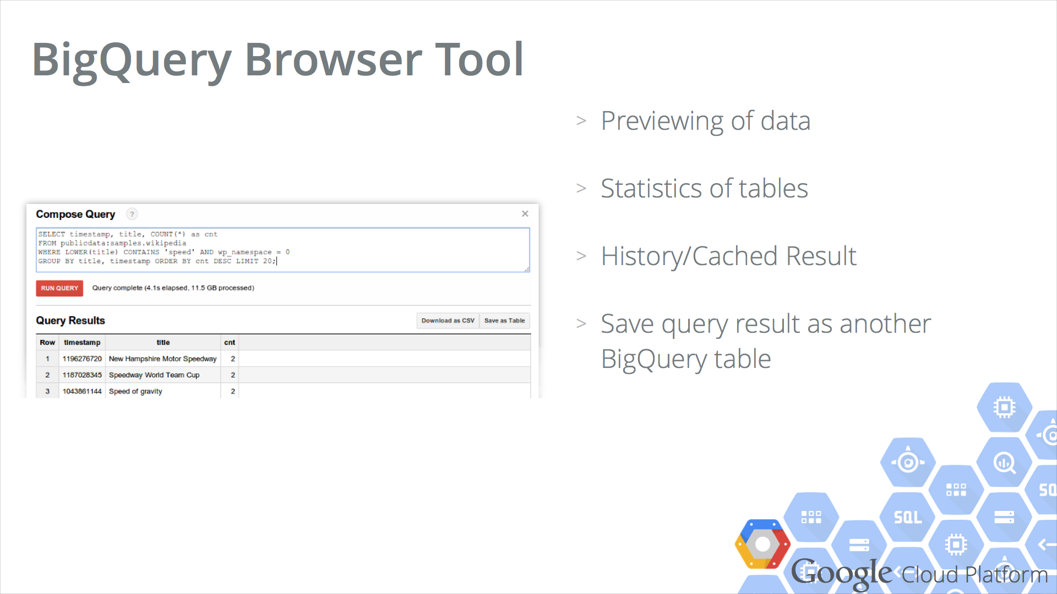

Slide 19
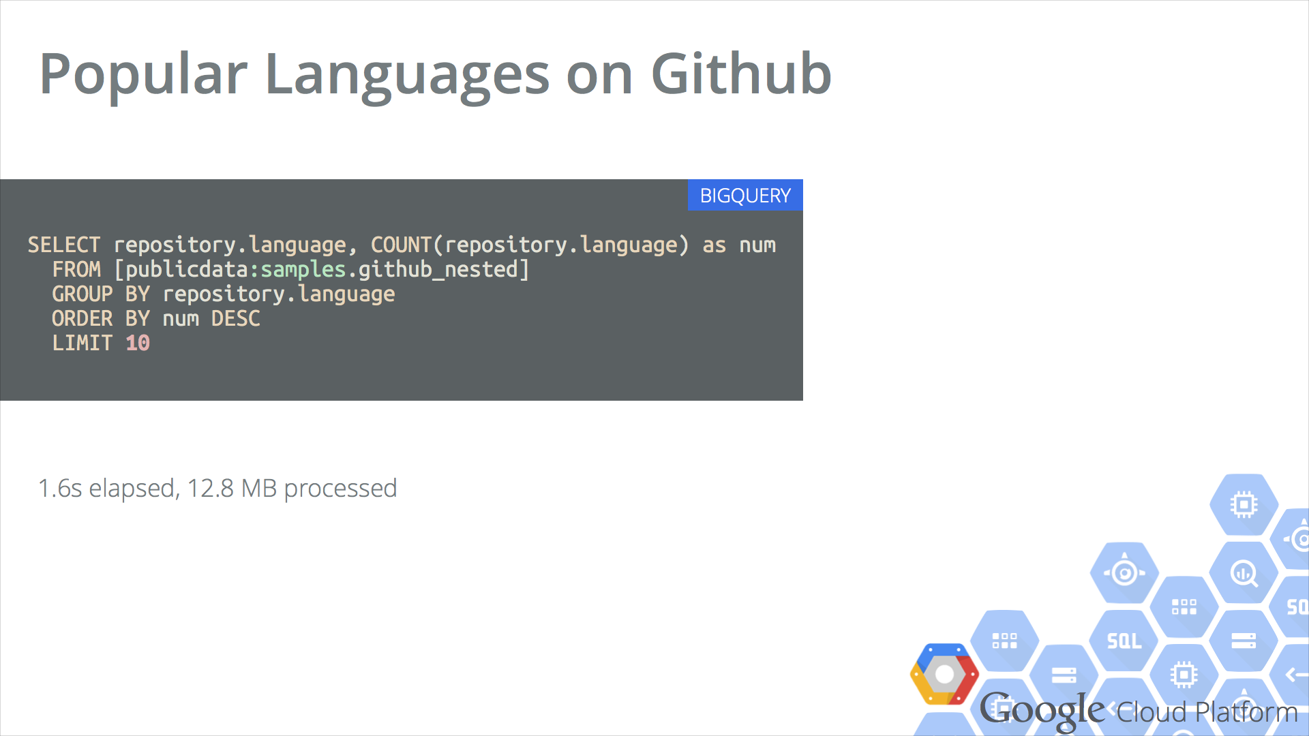

Slide 20
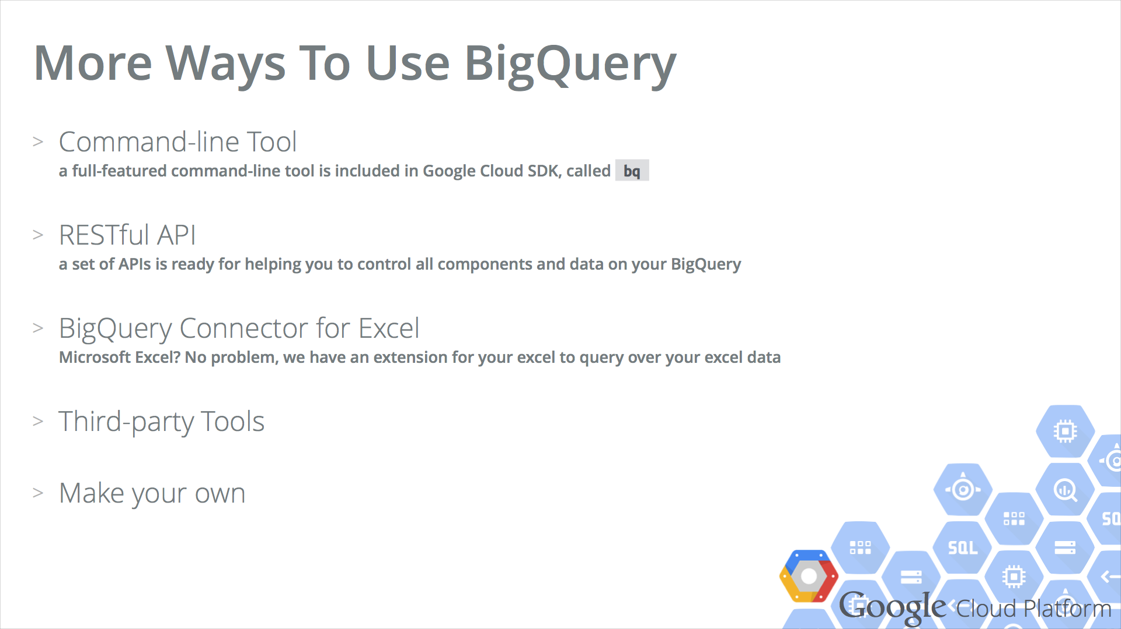

Slide 21
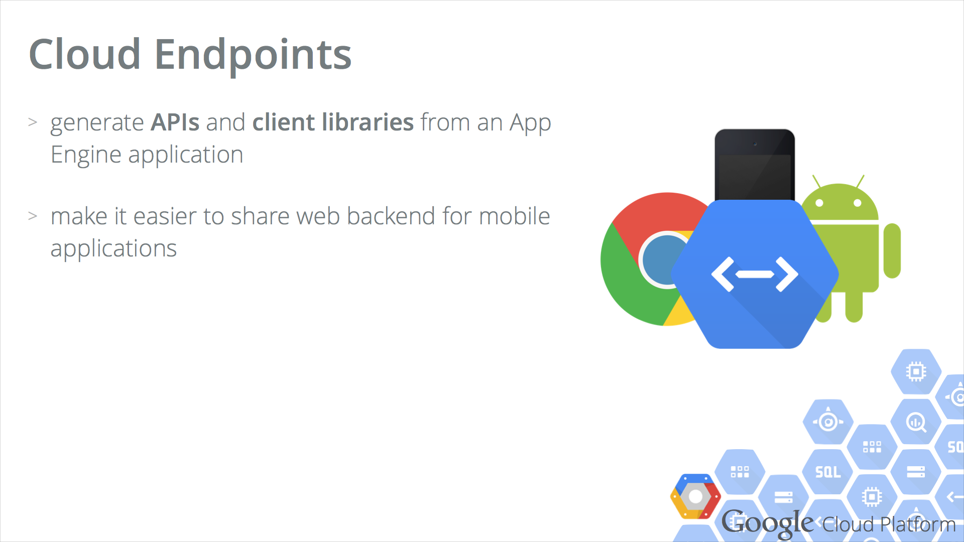

Slide 22
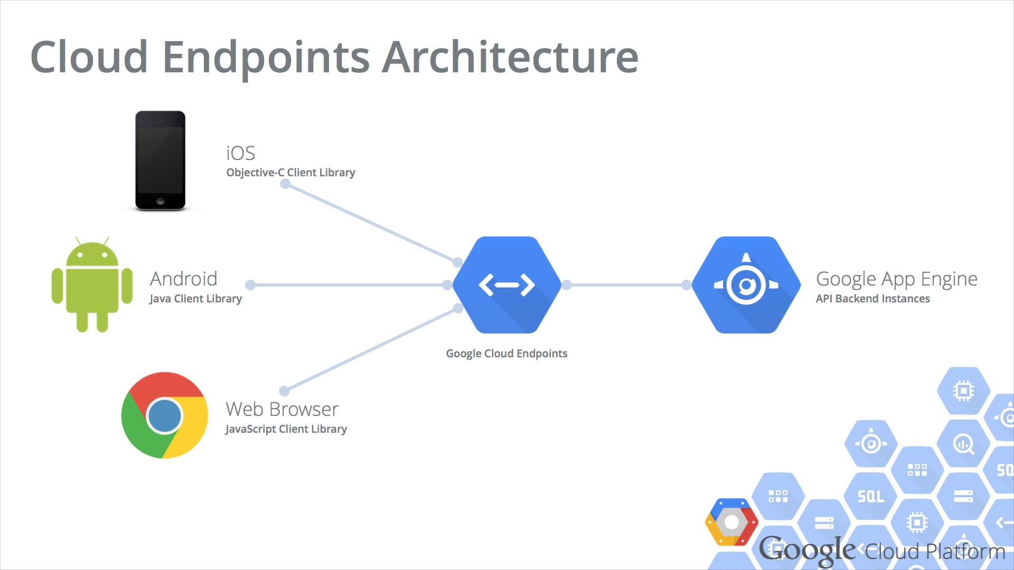

Slide 23
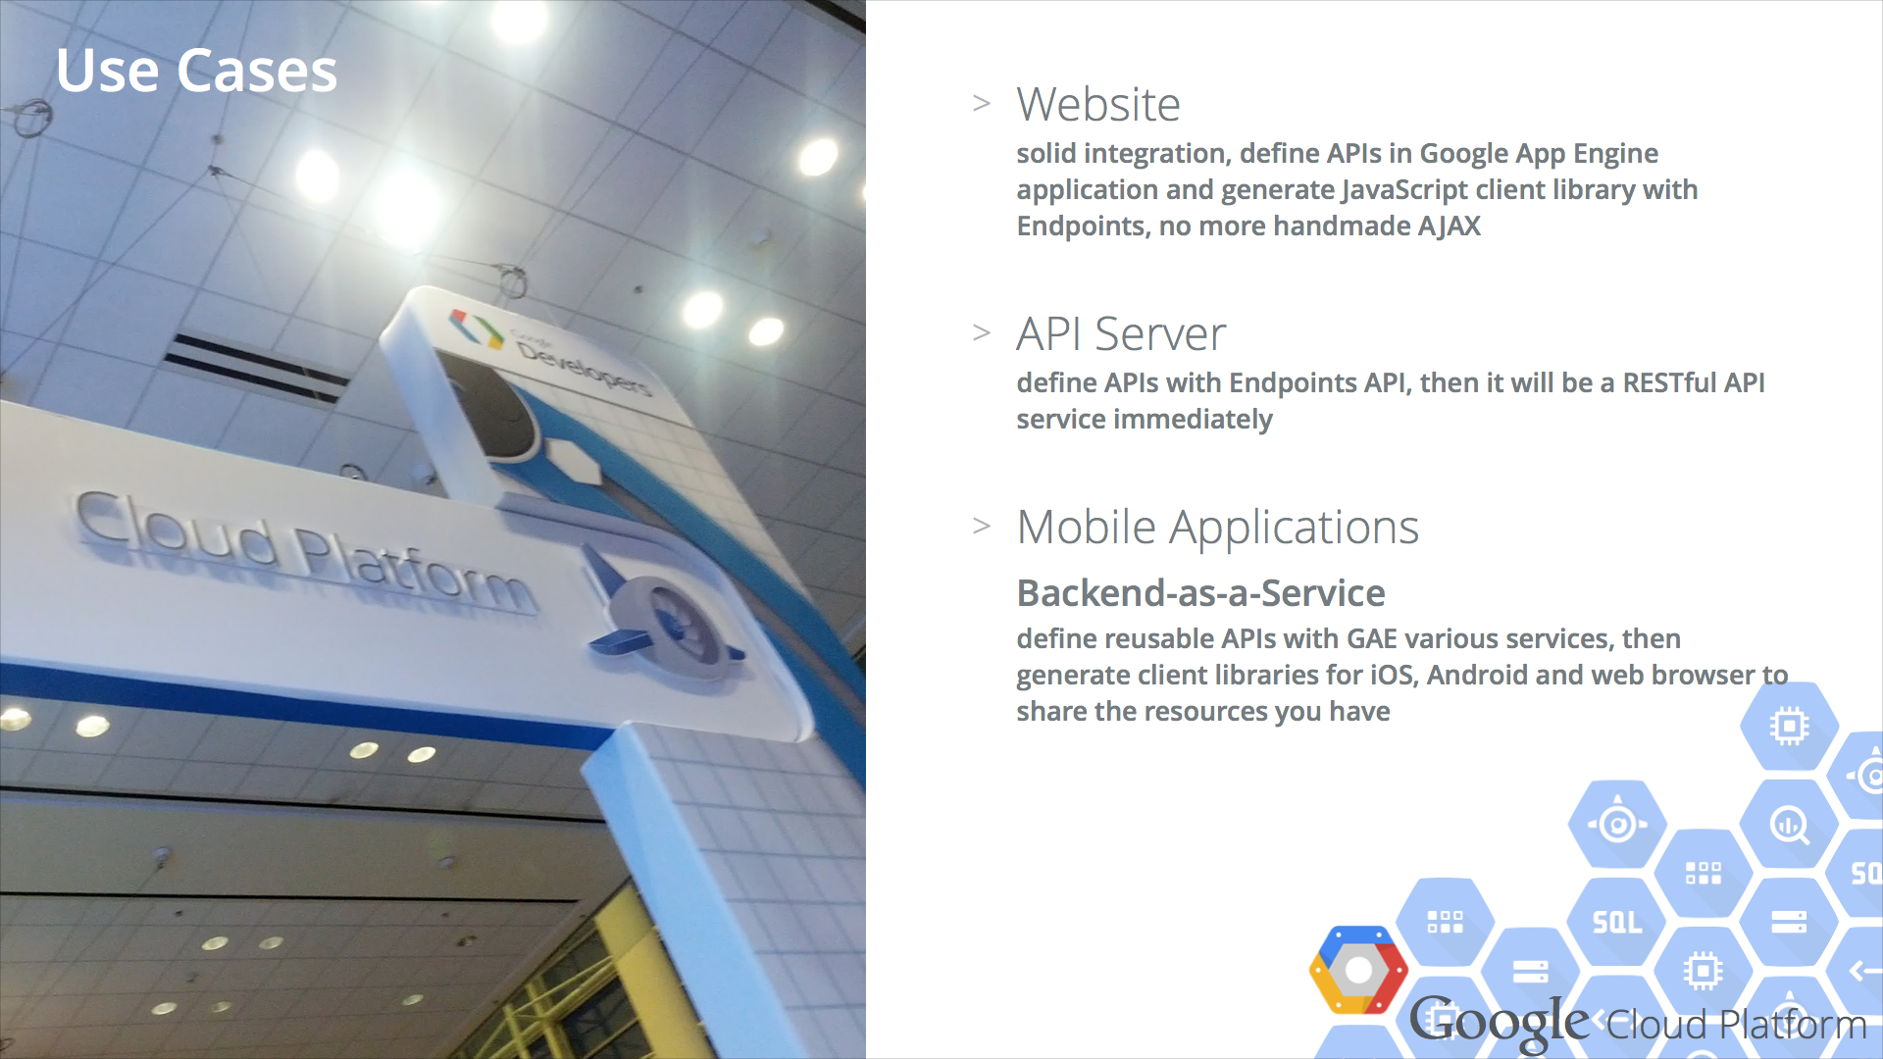

Slide 24
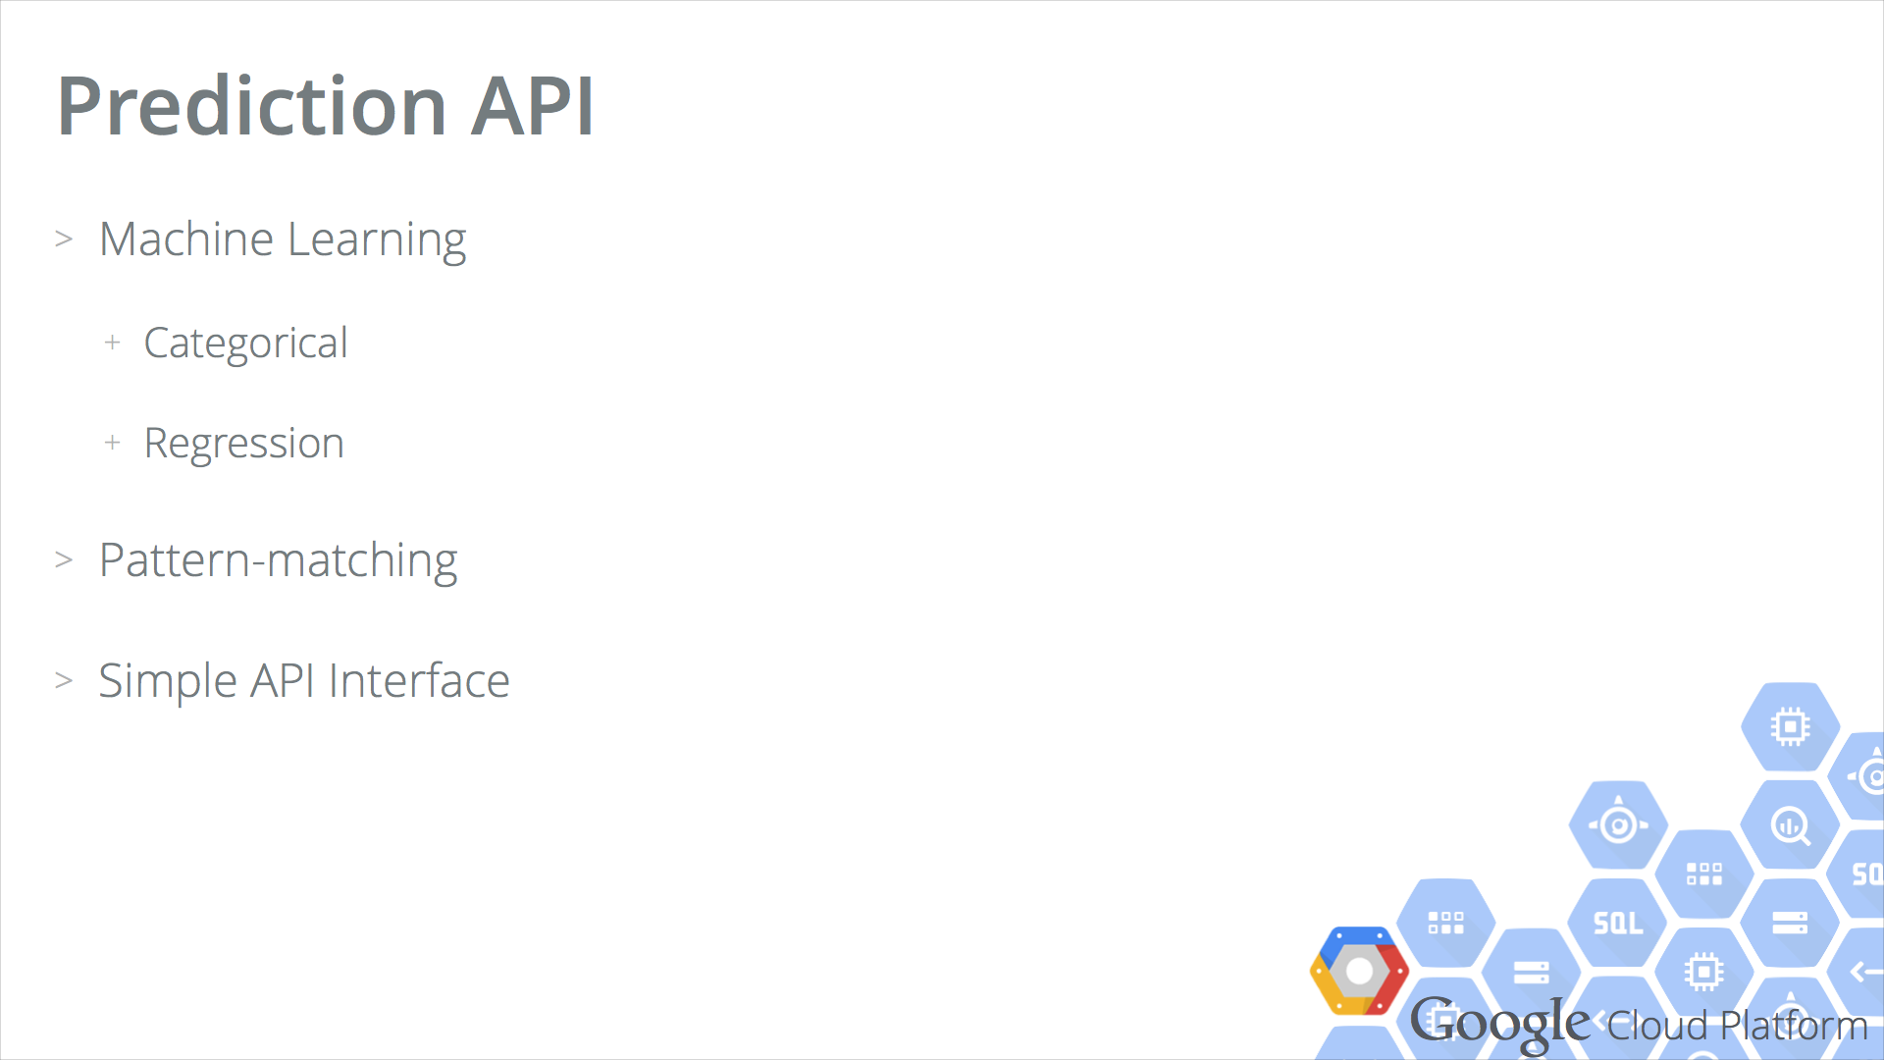

Slide 25
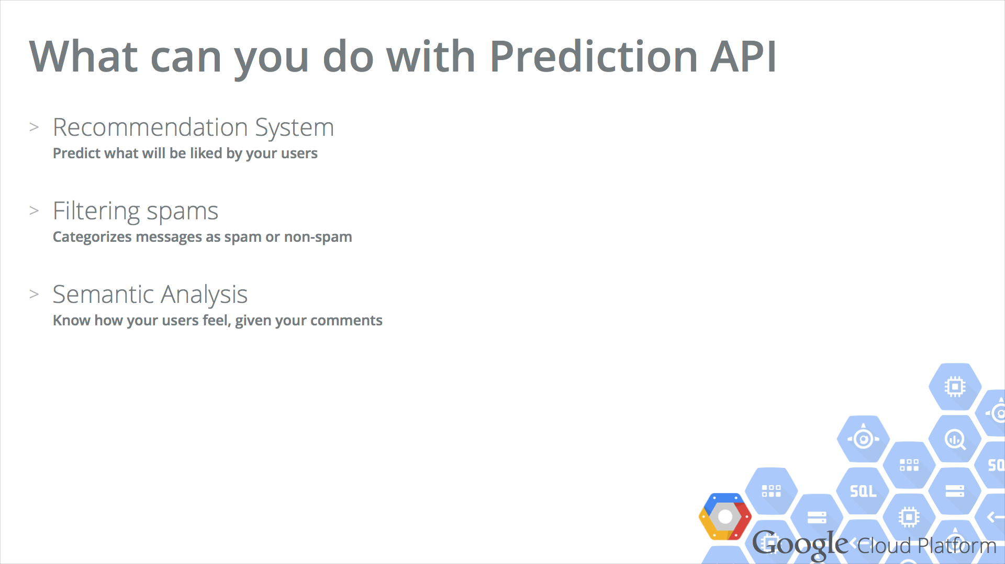

Slide 26
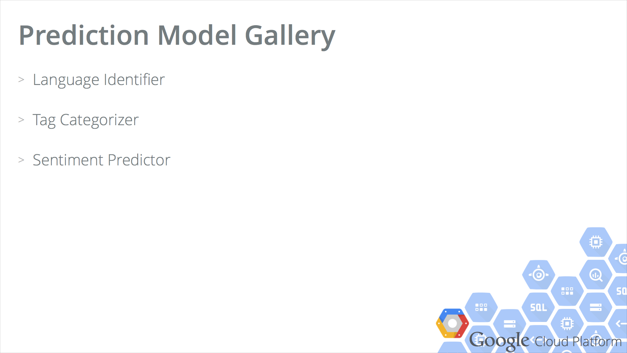

Slide 27
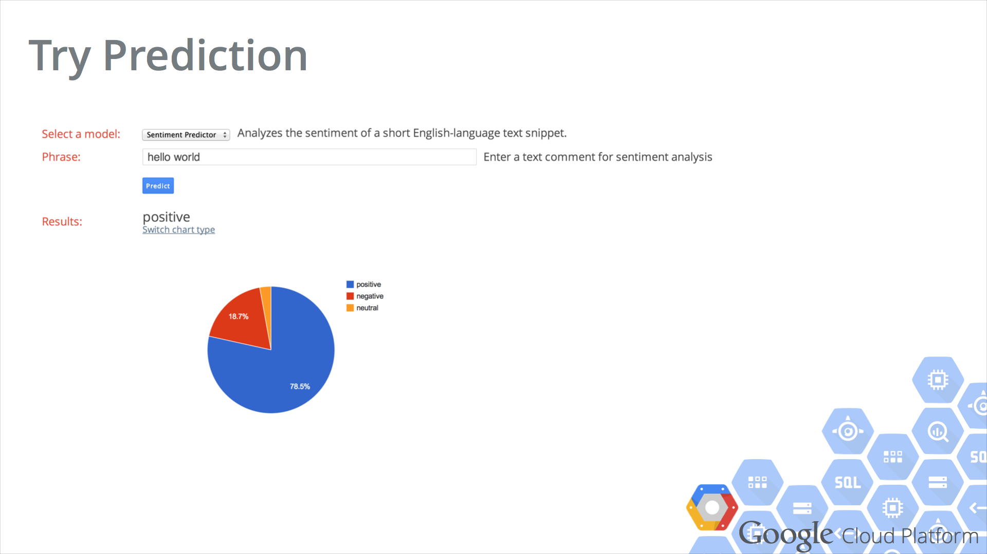

Slide 28
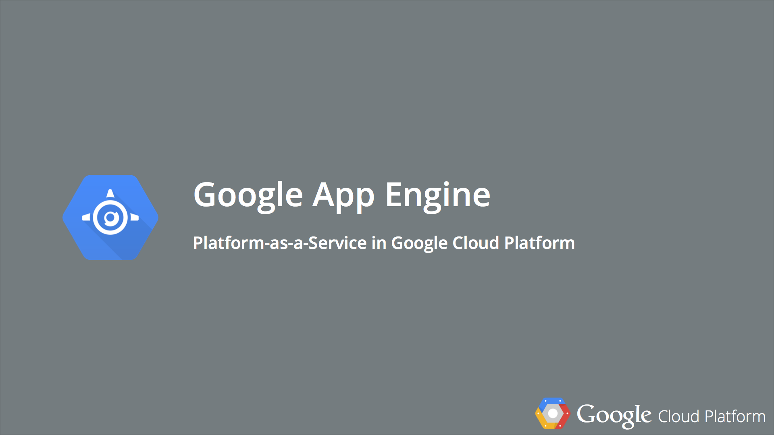

Slide 29
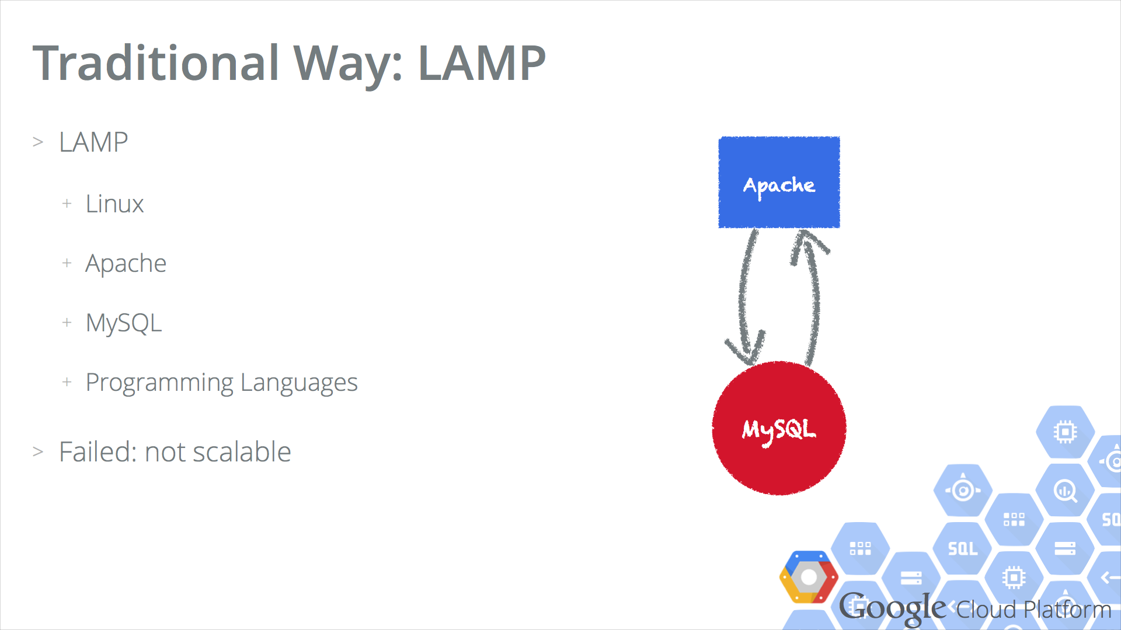

Slide 30
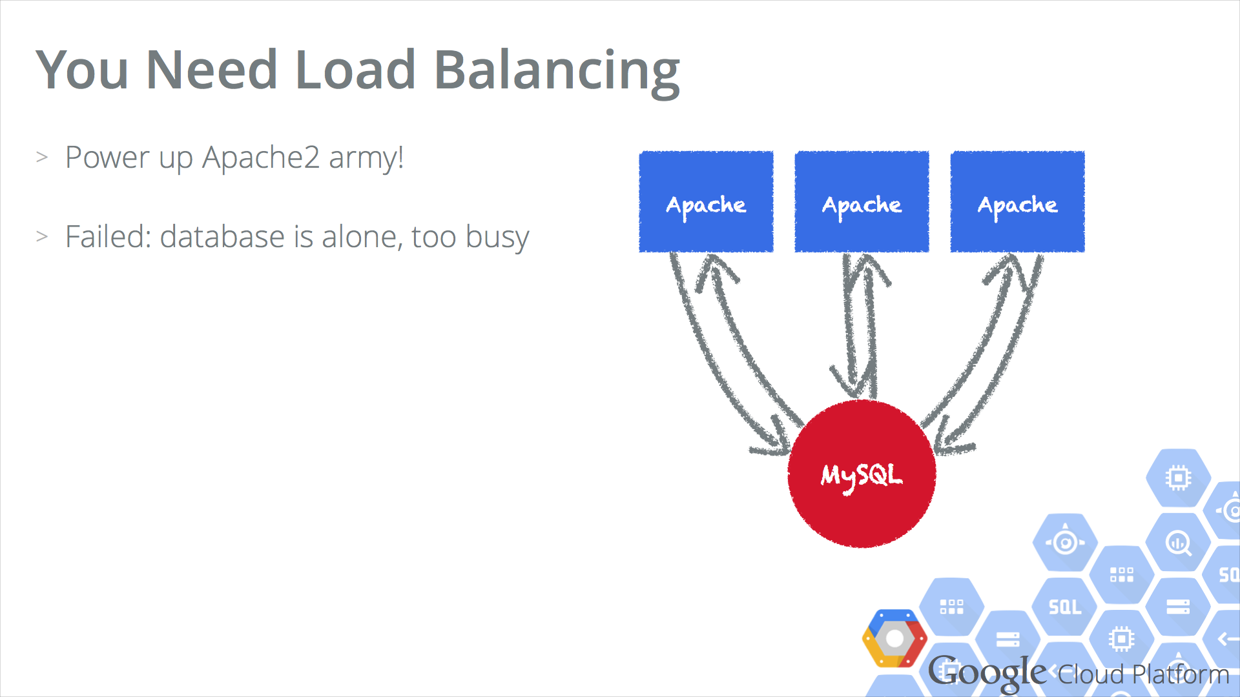

Slide 31
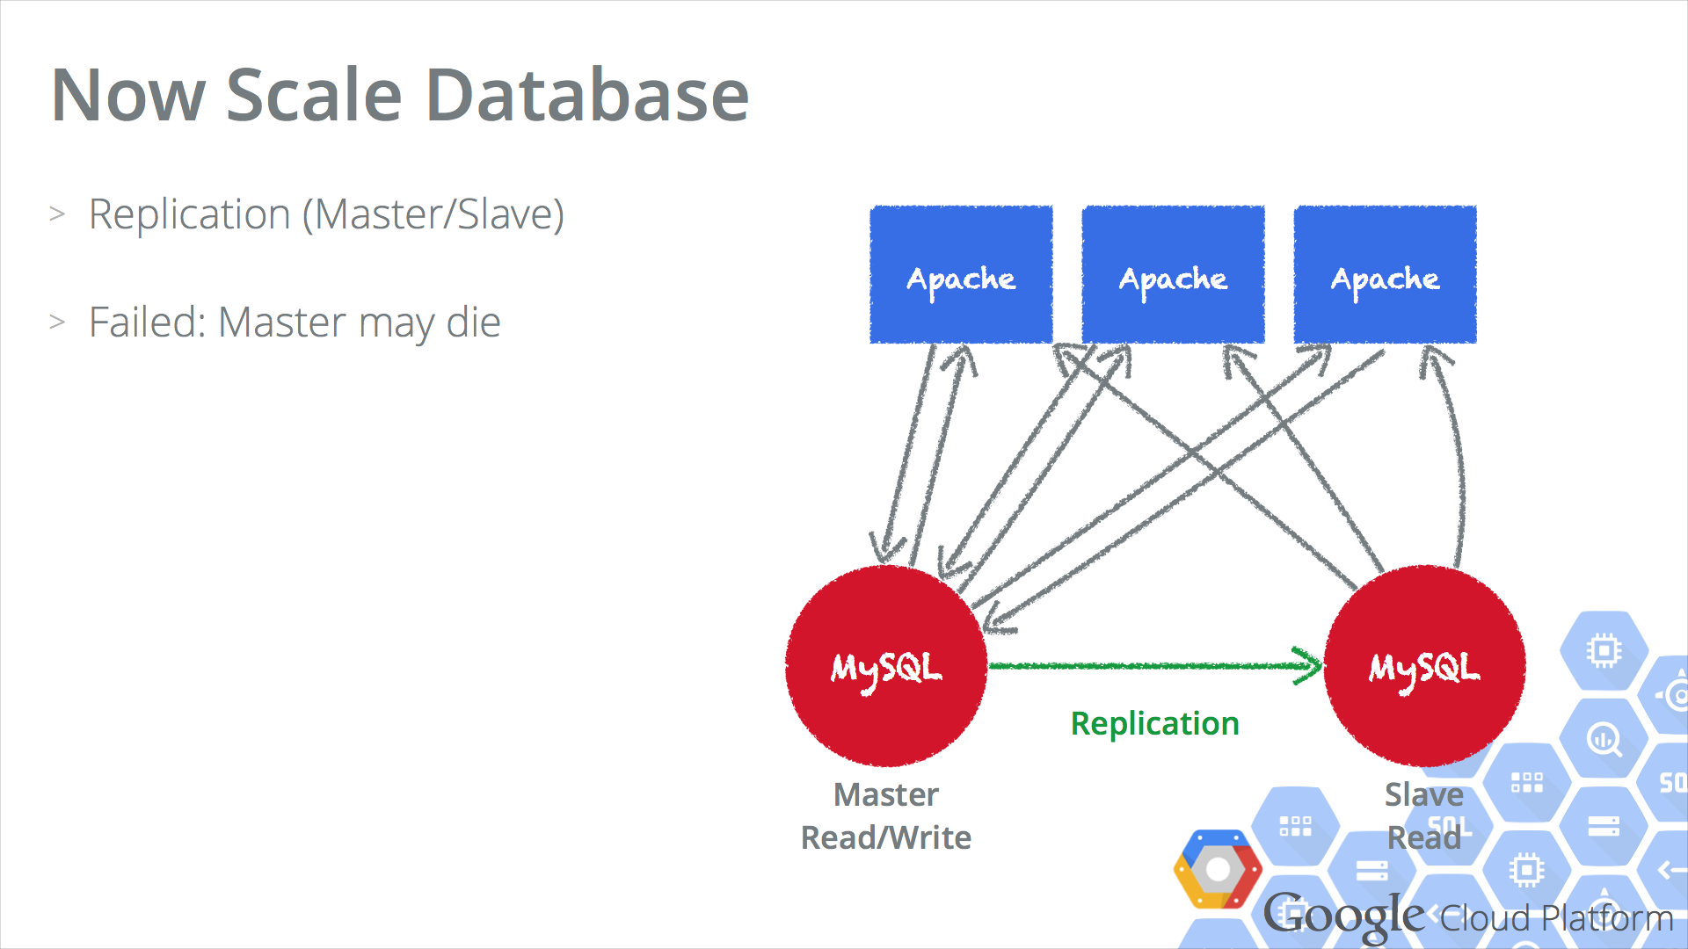

Slide 32
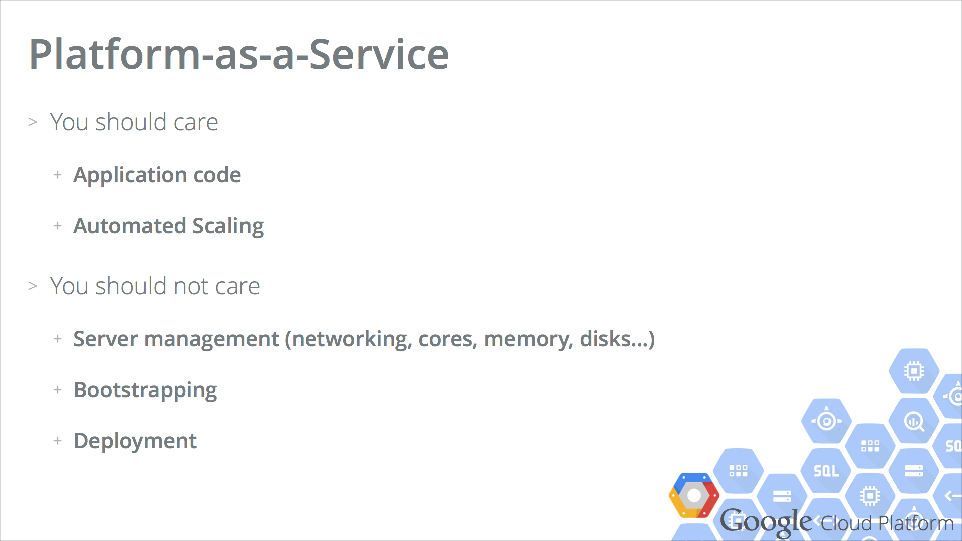

Slide 33
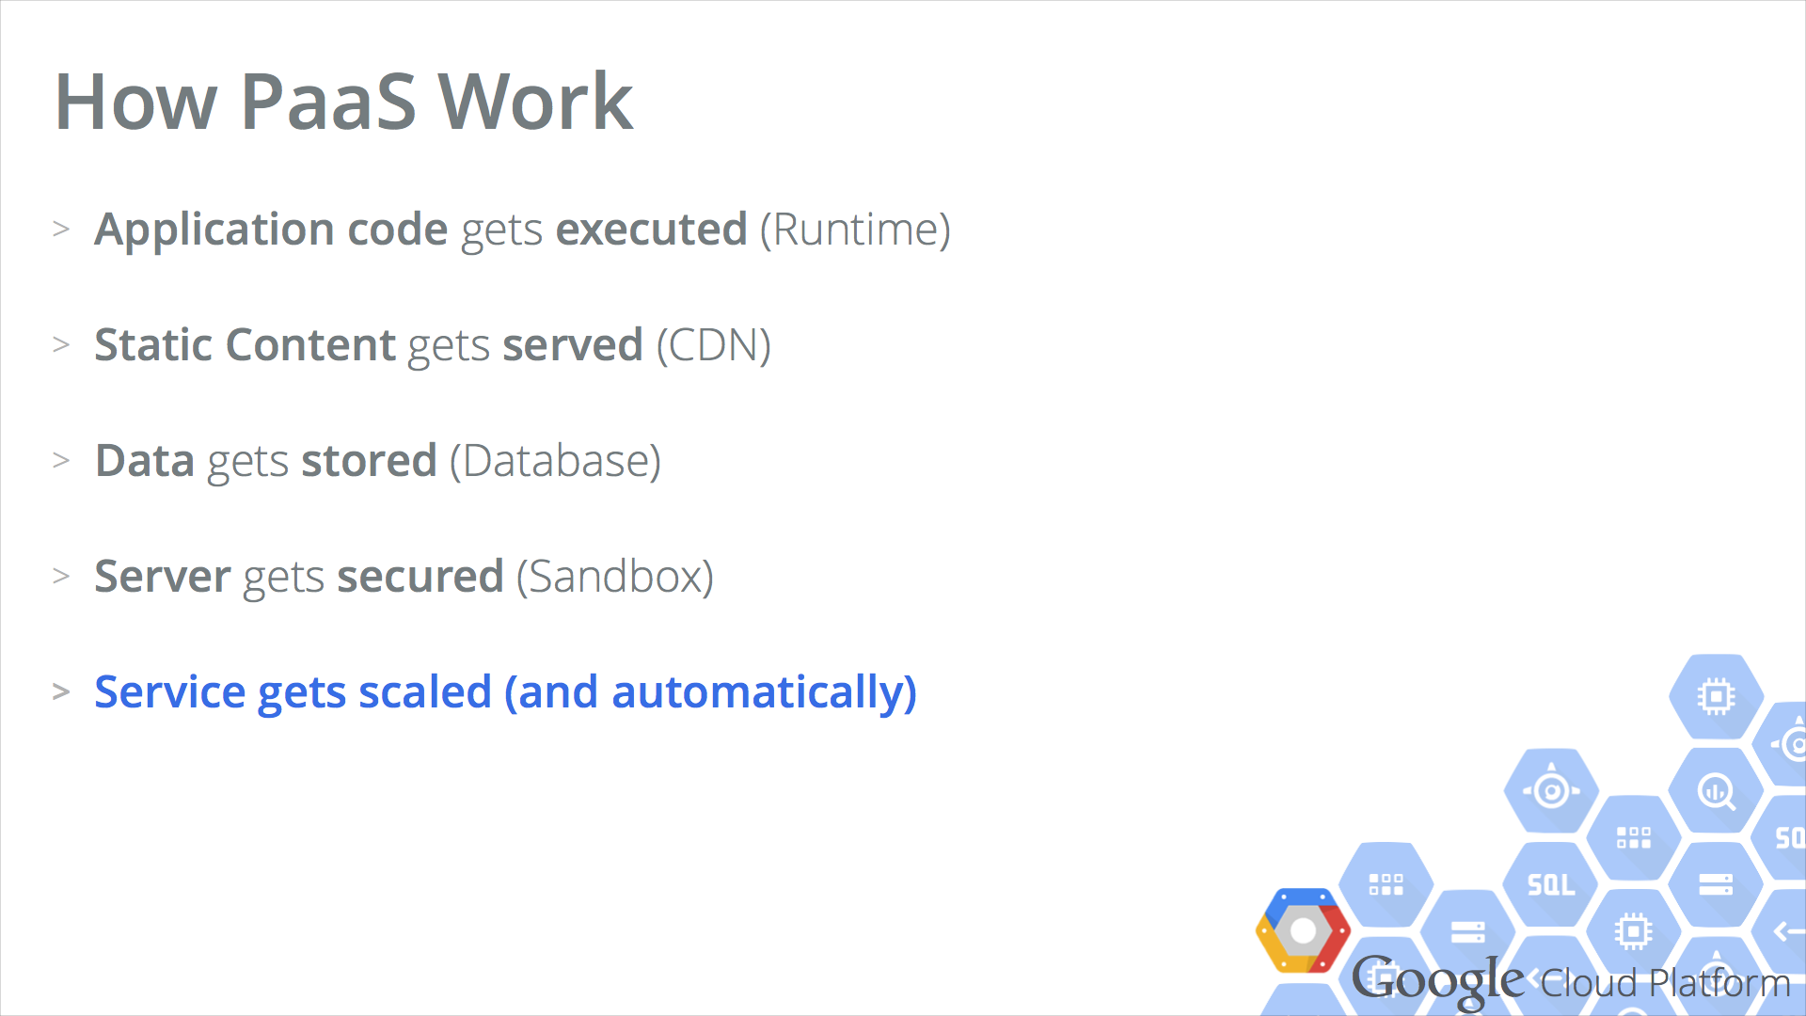

Slide 35
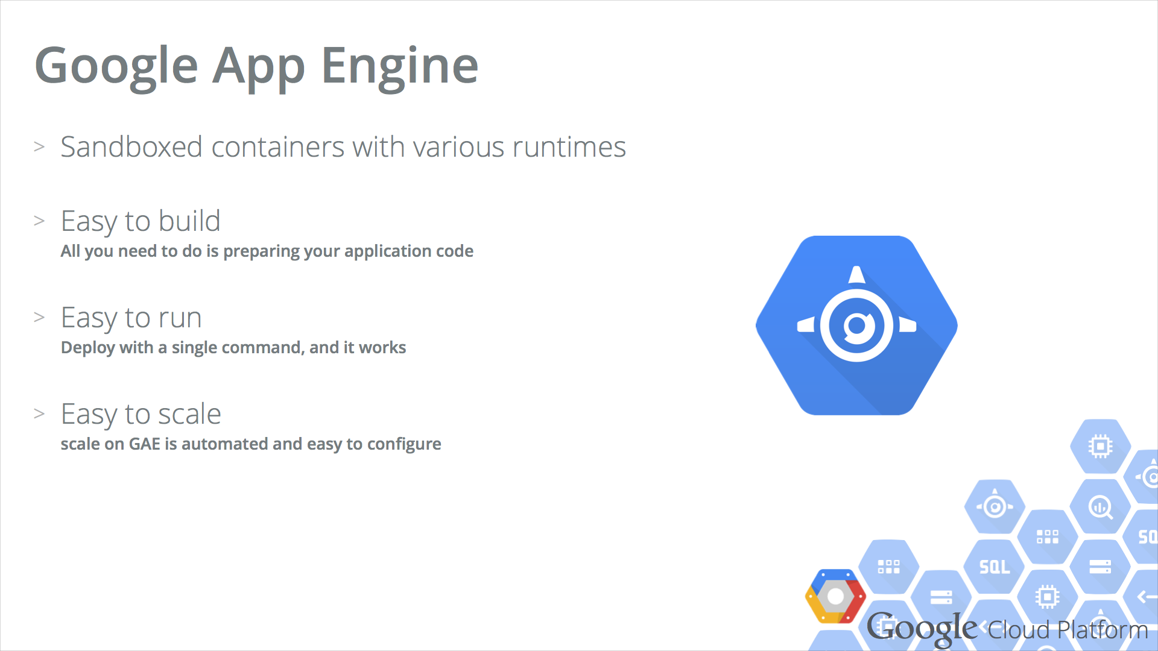

Slide 36
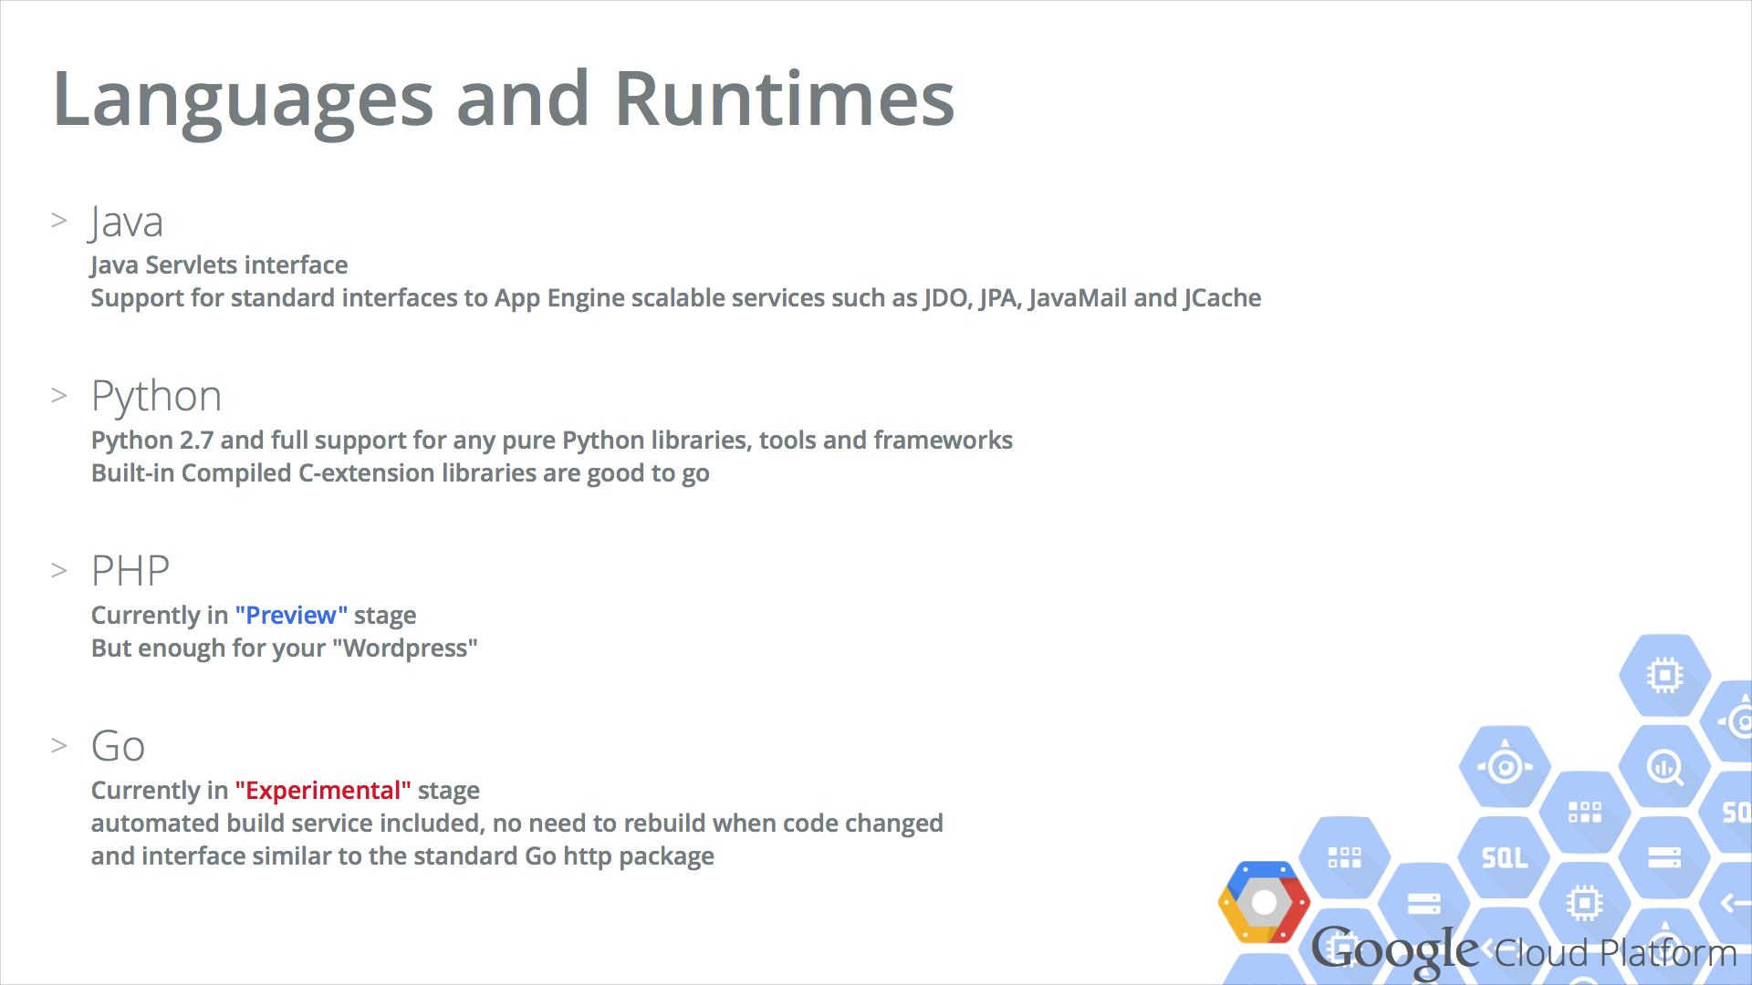

Slide 37
Reference Arch

Slide 38
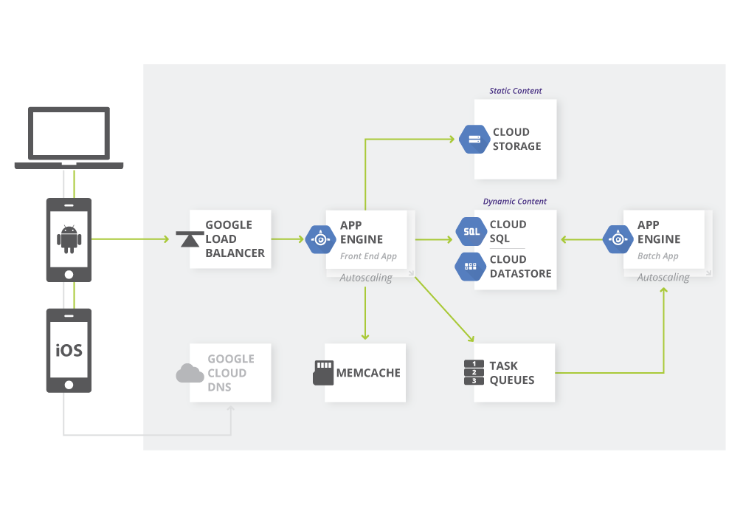
Web Apps

Slide 39
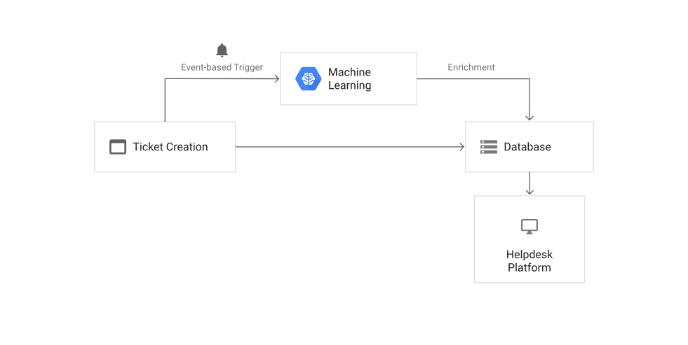
Serverless Machine Learning Model

Slide 40
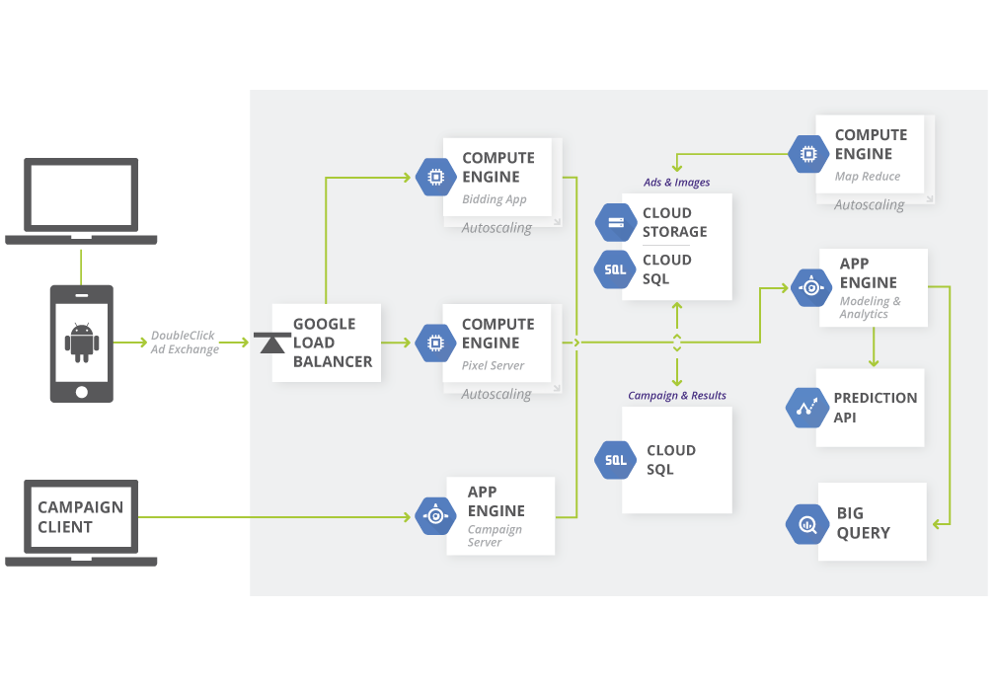
Real-time bidding

Slide 41
Solutions

Slide 42
Data Lifecycle
Ingest
Store
Process and Analyze
Explore and visualize

Slide 43
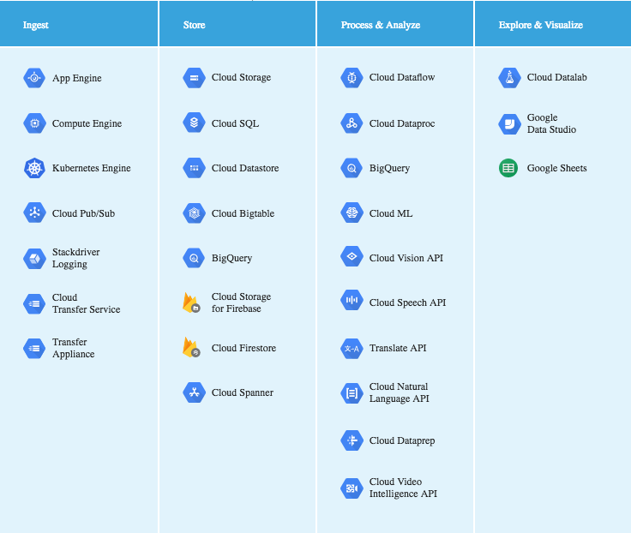

Slide 48
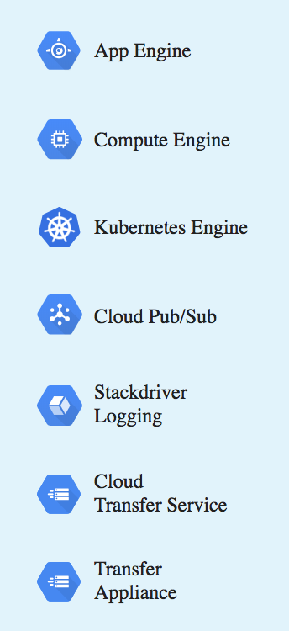
Data Lifecycle: Ingest
The first stage is to pull in the raw data, such as streaming data from devices.
There are a number of approaches you can take to collect raw data, based on the data’s size, source, and latency.

Slide 49
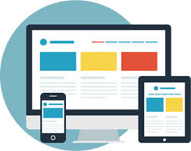
Data Lifecycle: Ingest
App: Data from app events, such as log files or user events, is typically collected in a push model, where the app calls an API to send the data to storage.

Slide 50
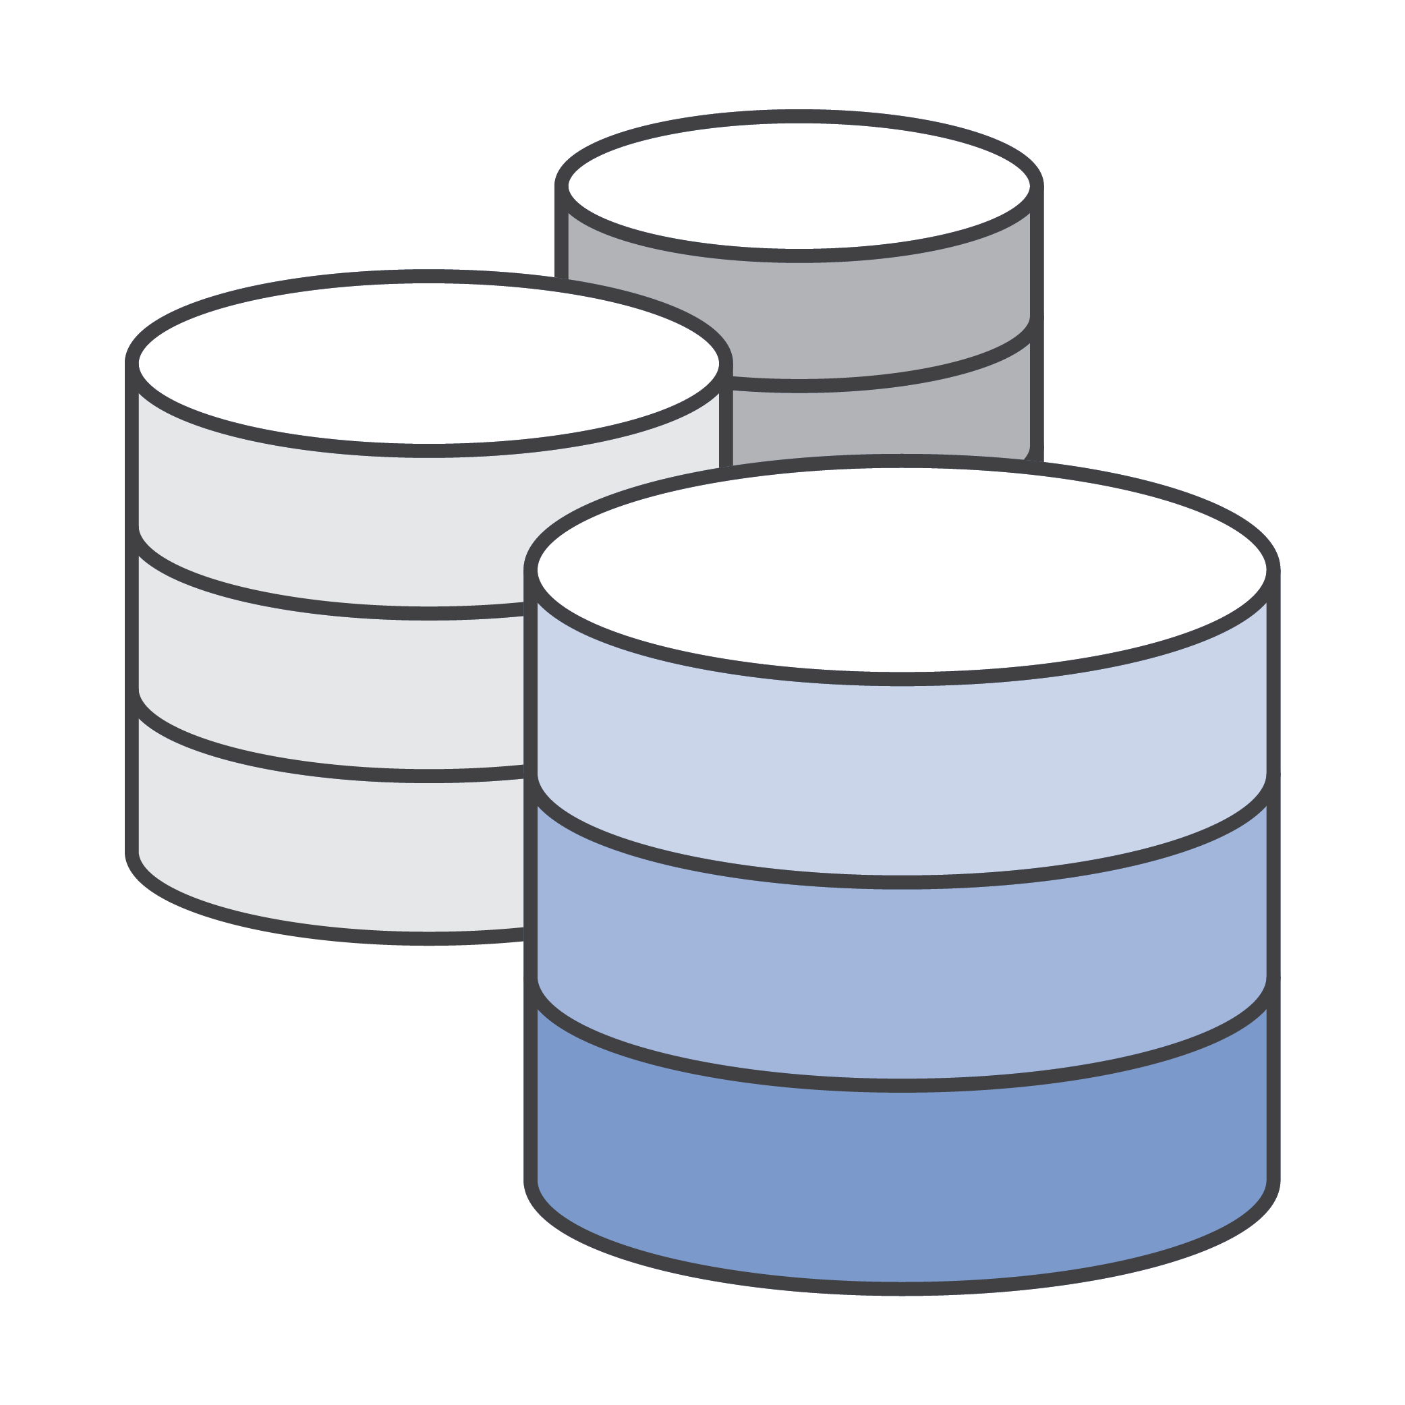
Data Lifecycle: Ingest
2. Streaming: The data consists of a continuous stream of small, asynchronous messages.
3. Batch: Large amounts of data are stored in a set of files that are transferred to storage in bulk.

Slide 51
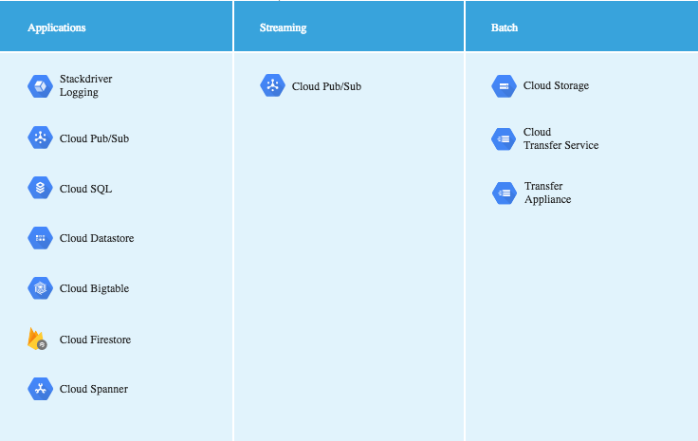

Slide 52
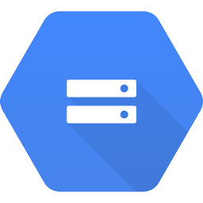
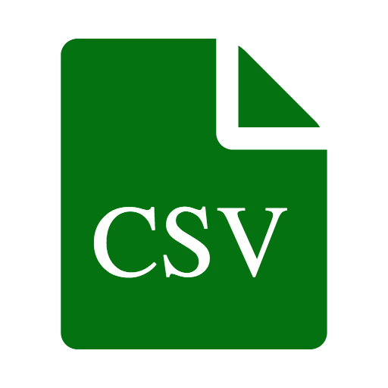
Data Lifecycle: Ingesting app data
Writing data to a file: An app outputs batch CSV files to the object store of Cloud Storage. From there, the import function of BigQuery, an analytics data warehouse, can pull the data in for analysis and querying.

Slide 53
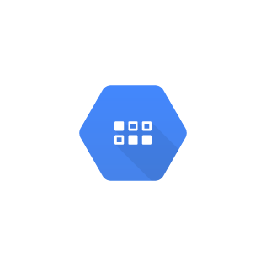
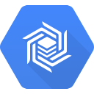
Data Lifecycle: Ingesting app data
Writing data to a database: An app writes data to one of the databases that GCP provides, such as the managed MySQL of Cloud SQL or the NoSQL databases provided by Cloud Datastore and Cloud Bigtable.

Slide 54
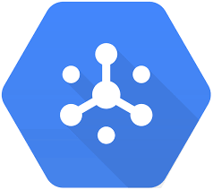
Data Lifecycle: Ingesting app data
Streaming data as messages: An app streams data to Cloud Pub/Sub, a real-time messaging service. A second app, subscribed to the messages, can transfer the data to storage or process it immediately in situations such as fraud detection.

Slide 55
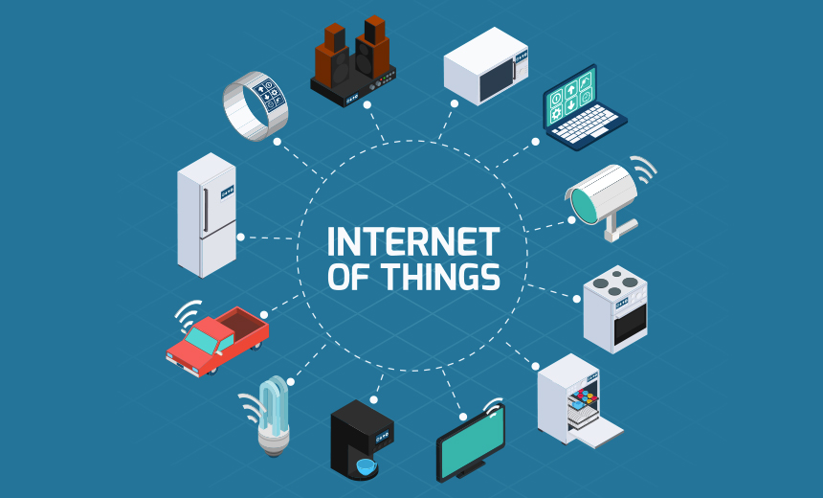
Data Lifecycle: Ingesting streaming data
Telemetry data: Internet of Things (IoT) devices are network-connected devices that gather data from the surrounding environment through sensors. Although each device might send only a single data point every minute, when you multiply that data by a large number of devices, you quickly need to apply big data strategies and patterns.

Slide 56
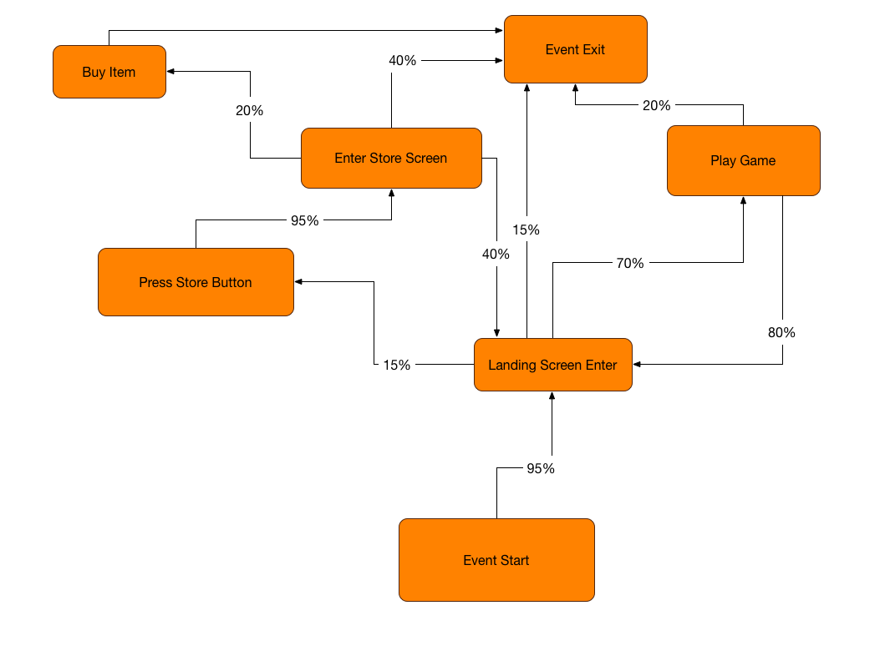
Data Lifecycle: Ingesting streaming data
User events and analytics: A mobile app might log events when the user opens the app and whenever an error or crash occurs. The aggregate of this data, across all mobile devices where the app is installed, can provide valuable information about usage, metrics, and code quality.

Slide 57
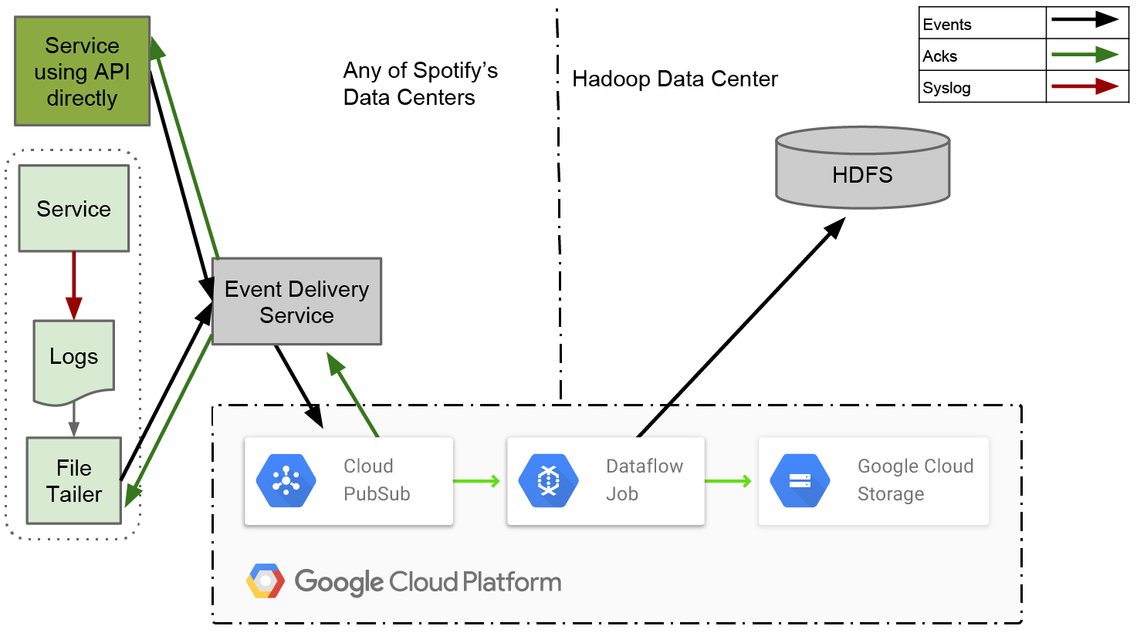
Spotify’s use case

Slide 58
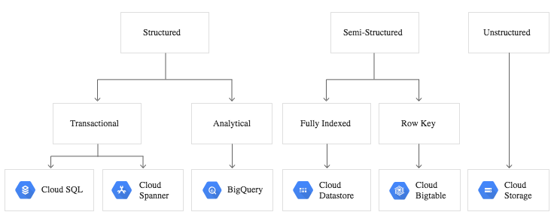
Data Lifecycle: Store

Slide 59
Data Lifecycle: Store - Cloud SQL
Cloud SQL: Managed MySQL and PostgreSQL engines
Financial transactions: Storing financial transactions requires ACID database semantics, and data is often spread across multiple tables, so complex transaction support is required.
User credentials: Storing passwords or other secure data requires complex field support and enforcement along with schema validation.
Customer orders: Orders or invoices typically include highly normalized relational data and multi-table transaction support when capturing inventory changes.

Slide 60
Data Lifecycle: Store - Cloud Bigtable
Cloud Bigtable: Managed wide-column NoSQL
Real-time app data: Cloud Bigtable can be accessed from apps running in App Engine flexible environment, GKE, and Compute Engine for real-time live-serving workloads.
Stream processing: As data is ingested by Cloud Pub/Sub, Cloud Dataflow can be used to transform and load the data into Cloud Bigtable.
IoT time series data: Data captured by sensors and streamed into GCP can be stored using time-series schemas in Cloud Bigtable.

Slide 61
Data Lifecycle: Store - Cloud Spanner
Cloud Spanner: Horizontally scalable relational database
Financial services: Financial services workloads require strong consistency across read/write operations. Cloud Spanner provides this consistency without sacrificing high availability.
Ad tech: Latency is a key consideration in the ad tech space. Cloud Spanner facilitates low-latency querying without compromising scale or availability.
Retail and global supply chain: The need for global scale can force supply chain experts to make a trade-off between consistency and maintenance costs. Cloud Spanner offers automatic, global, synchronous replication with low latency, which means that data is always consistent and highly available.

Slide 62
Data Lifecycle: Store - Cloud Firestore
Cloud Firestore: Flexible, scalable NoSQL database
Chat and social: Store and retrieve images, audio, video, and other user-generated content.
Mobile games:Keep track of game progress and statistics across devices and device platforms.

Slide 63
Data Lifecycle: Process and Analyze
Processing: Data from source systems is cleansed, normalized, and processed across multiple machines, and stored in analytical systems.
Analysis: Processed data is stored in systems that allow for ad-hoc querying and exploration.
Understanding: Based on analytical results, data is used to train and test automated machine-learning models.

Slide 64
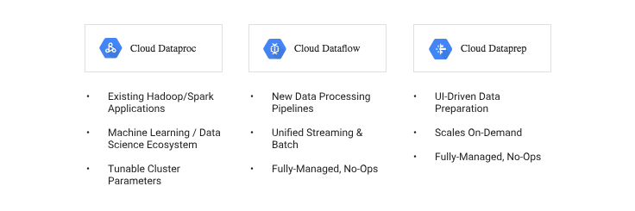
Data Lifecycle: Process and Analyze

Slide 65

Data Lifecycle: Explore and visualize
Google Cloud datalab for Data science purpose

Slide 66
GCP minilabs

Slide 67
Analyzing Financial Time Series Using BigQuery and Cloud Datalab
Setting up
Select or create a GCP project.
https://console.cloud.google.com/cloud-resource-manager

Slide 68

Analyzing Financial Time Series Using BigQuery and Cloud Datalab
Enable billing

Slide 69
Analyzing Financial Time Series Using BigQuery and Cloud Datalab
Enable API
https://console.cloud.google.com/flows/enableapi

Slide 70

Analyzing Financial Time Series Using BigQuery and Cloud Datalab
Start a Cloud shell
Type in the following command
$ datalab create <instance-name>

Slide 71


Slide 72

Analyzing Financial Time Series Using BigQuery and Cloud Datalab
Open the web preview to access datalab

Slide 73


Slide 74

Analyzing Financial Time Series Using BigQuery and Cloud Datalab
New datalab notebook

Slide 75
Analyzing Financial Time Series Using BigQuery and Cloud Datalab
Copy this and execute
!gsutil cp gs://solutions-public-assets/bigquery-datalab/* .

Slide 76
GCP labs

Slide 77
Building a Node.js web app using GCP
https://docs.google.com/presentation/d/10pHd3kr54T87Q2x-idAU7QHoGEVzKEaU4BoGMN2Kh2o/edit?usp=sharing

